Slide 1
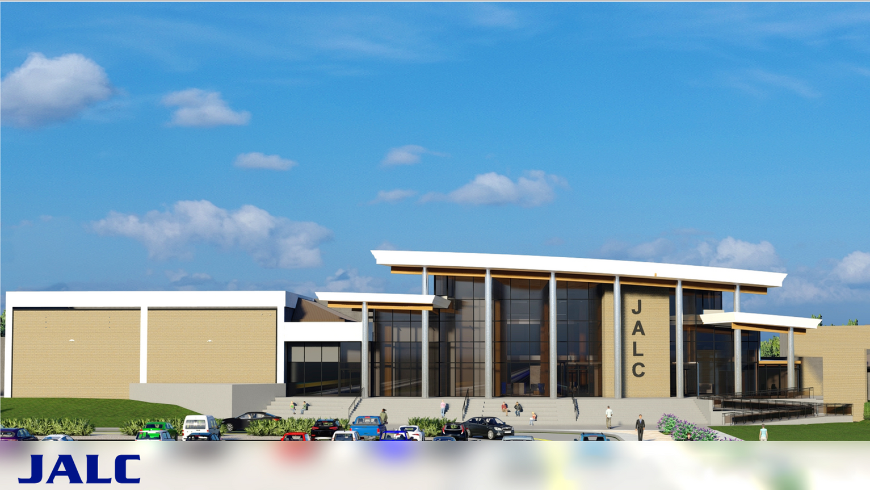
December 2025
JOHN A. LOGAN COLLEGE
SCORECARD
PATHWAY TO SUCCESS

Slide 2
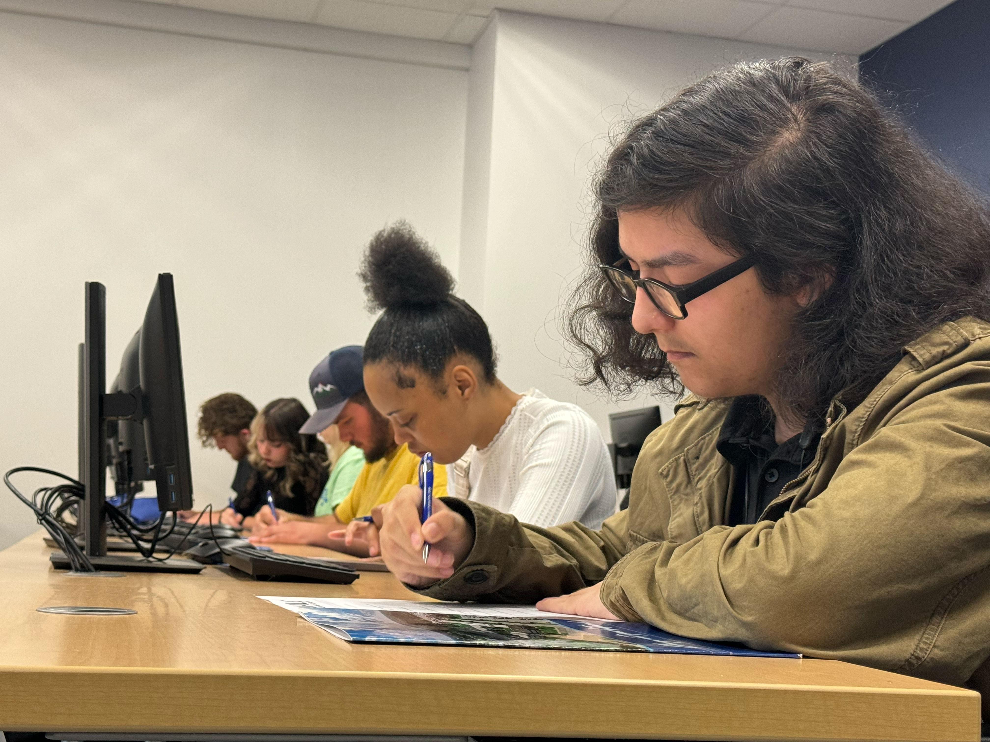
STRATEGIC PLAN FOR COLLEGE SUCCESS
Building a Brighter Future Together
The College Scorecard was created to provide our community and campus with a snapshot of how we, as a college, are performing in the key areas of enrollment, retention, completion, and student satisfaction. This summary provides an overview and all metrics and are updated annually. The overarching enrollment target of the SEM Plan is to increase student headcount and credit hours by 4% by Fall 2027. Data from Fall 2022 was used as the benchmark and this scorecard reflects FY 2024 numbers. The SEM Plan has established four goals, each with their own tactics, to provide guidance for reaching the four percent increase in enrollment.
The College Scorecard is a quantitative measurement of our ability to execute the goals within our strategic enrollment plan and we continue to look for new and innovative measurements that can help us to better measure our progress.
The green check mark next to each metric denote successful completion of the goal. Our focus is on helping our students to achieve their educational goals and continuing our long-term vision to provide innovation and equitable learning opportunities, inspire growth, cultivate learning, and promote cultural understanding.

Slide 3


GOAL 1: INCREASE STUDENT HEADCOUNT AND CREDIT HOURS
= Metric has been met
Tactics
Logan Spotlight Event
Highflex Offerings
Academic and Student Affairs departments hosted a Spotlight event on Oct. 24, 2023. This was our first attempt at hosting a spotlight on all of our academic programs, inclusive of transfer educational programming, career and technical education programming, as well as our GED and alternative high school opportunities.
The nursing department is piloting this new modality with PNE 105 and hyflex has been identified as “F” for modality in course offerings. More offerings are being considered for general education courses.
New and Innovative Programs
Strong Pathways Logan Academy
The following have been created; Media Arts AA, Digital Media AAS, Hospitality Management AAS, Personal Training Cert., and Phlebotomy Tech Cert. and others pending.
Hosted various recruitment visits to the Logan Academy classes in the evening at JALC and Marion locations.
College Bridge
Fast Track Offerings
Successfully launched bridge program at our district high schools to serve underrepresented students. In total, 205 students participated in the College Bridge, 113 started the Summer Bridge ORI 100 course, and 103 students successfully completed the course.
Fast Track Offerings: 4-, 8-, and 12-week offerings as well as winter session have been implemented and evening cohort created for Carbondale High School.
Alumni Relations
Healthcare Credentials
During spring and summer 2025 after promotion at graduation the alumni association saw a 15% increase in membership.
Medical lab tech and surgical tech now offered on our campus and phlebotomy added.

Slide 4
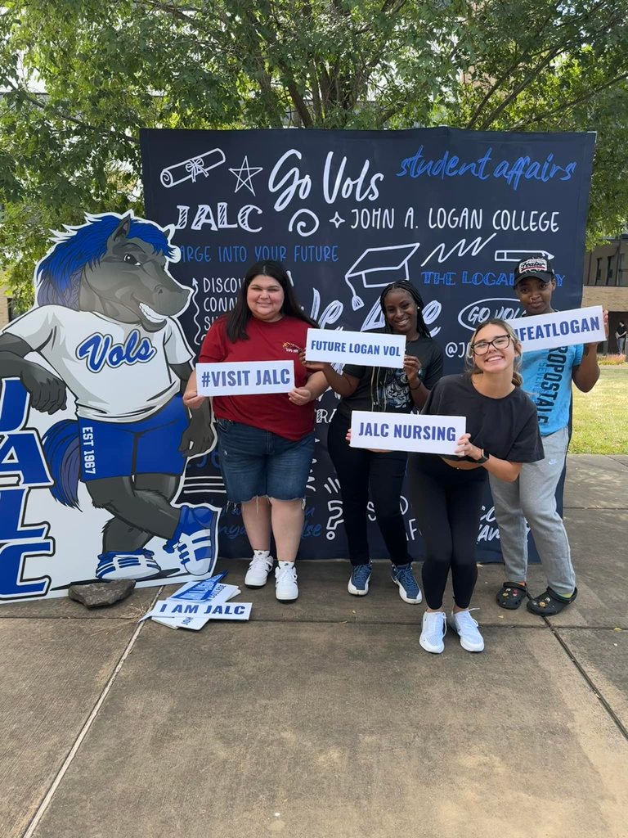
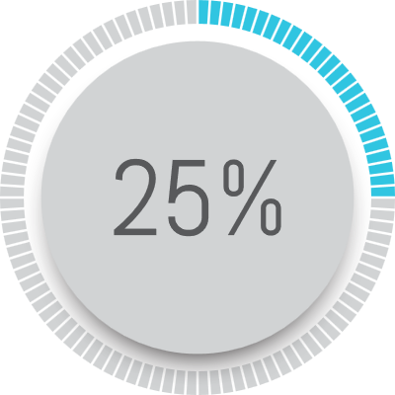
GOAL 1: INCREASE STUDENT HEADCOUNT AND CREDIT HOURS
= Metric has been met
Tactics Continued
Community Outreach
The College has made a larger effort in 2025 to participate in community events and host community event. Additional efforts included table setups at local libraries, hosting community wide events on campus, and community service projects to donate time and resources to community organizations.
Alternate Learning Locations
Carbondale Community High School has been added as an alternate location to over evening cohort fast track options.
Programs for Neurodivergent Populations
The college is seeking partnerships with Options to determine a direction and creating a Neurodivergent Programs Task Force in FY25. No new progress.
Expansion of Apprenticeships
Apprenticeship opportunities were moved to the Assistant Dean of Academic Affairs to supervise and monitor. We have a strong community partner Man-Tra-Con to help make further advancements in creating apprenticeships with employers.

Slide 5
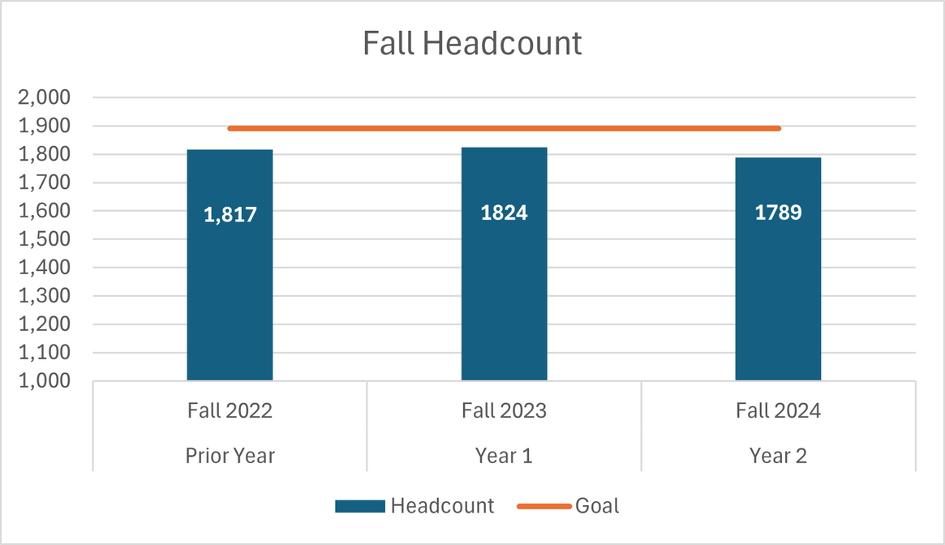
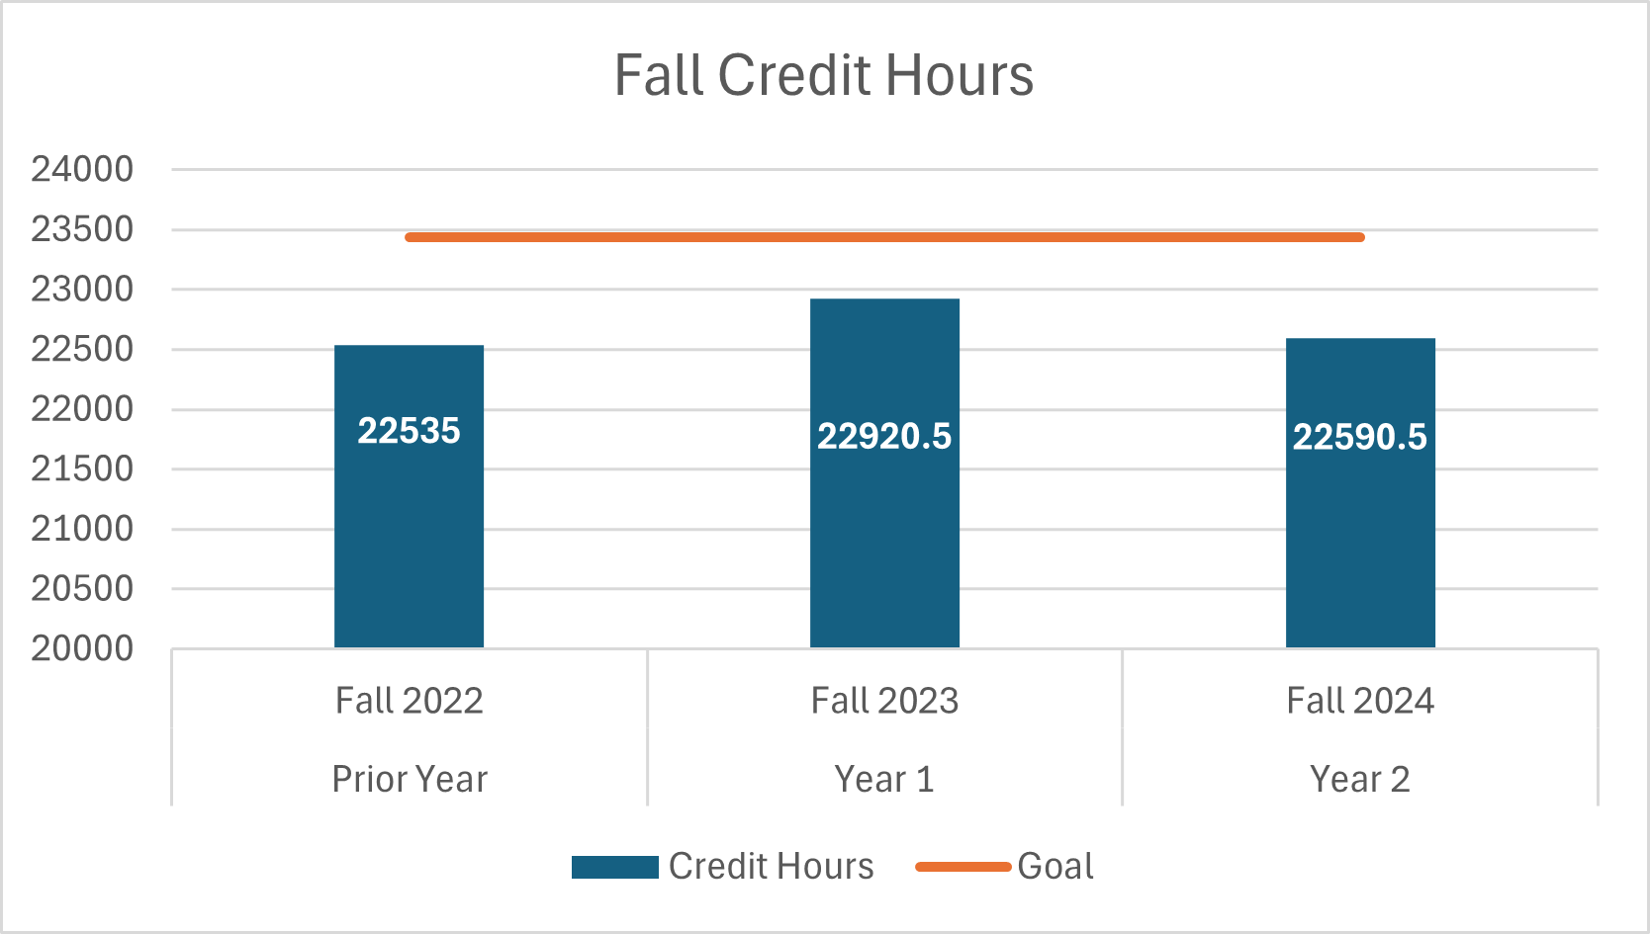
GOAL 1: INCREASE STUDENT HEADCOUNT AND CREDIT HOURS RESULTS

Slide 6
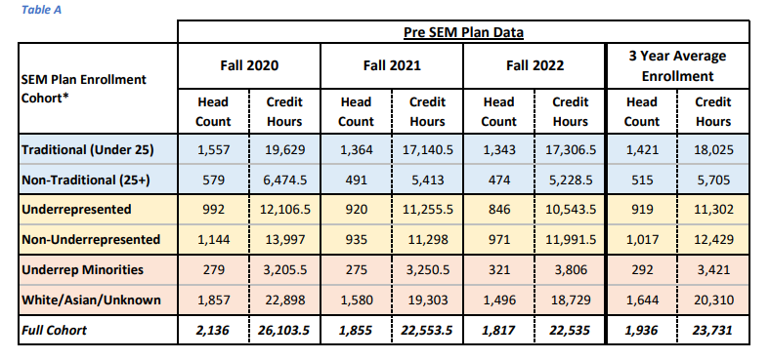
Pre SEM Plan Data
*Cohorts consist of students enrolled in 6 or more credit hours. Excluding Dual Credit, Workforce, and ABE.
Underrepresented-Includes students from the initial cohort that are of any race/ethnicity other than white, Asian, or Unknown OR are Pell recipients OR listed as having a disability.

Slide 7
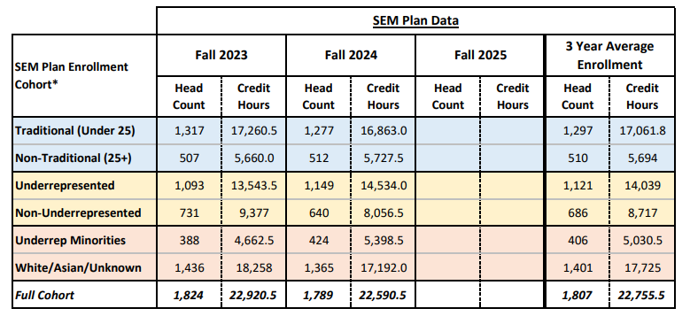
Enrollment Cohort: SEM Plan Data
*Cohorts consist of students enrolled in 6 or more credit hours. Excluding Dual Credit, Workforce, and ABE.
Underrepresented-Includes students from the initial cohort that are of any race/ethnicity other than white, Asian, or Unknown OR are Pell recipients OR listed as having a disability.

Slide 8
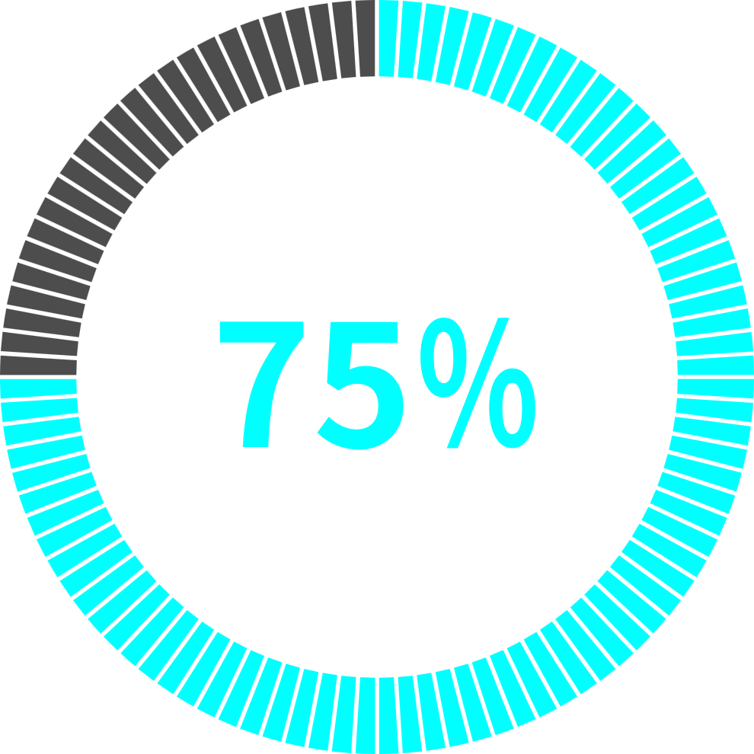

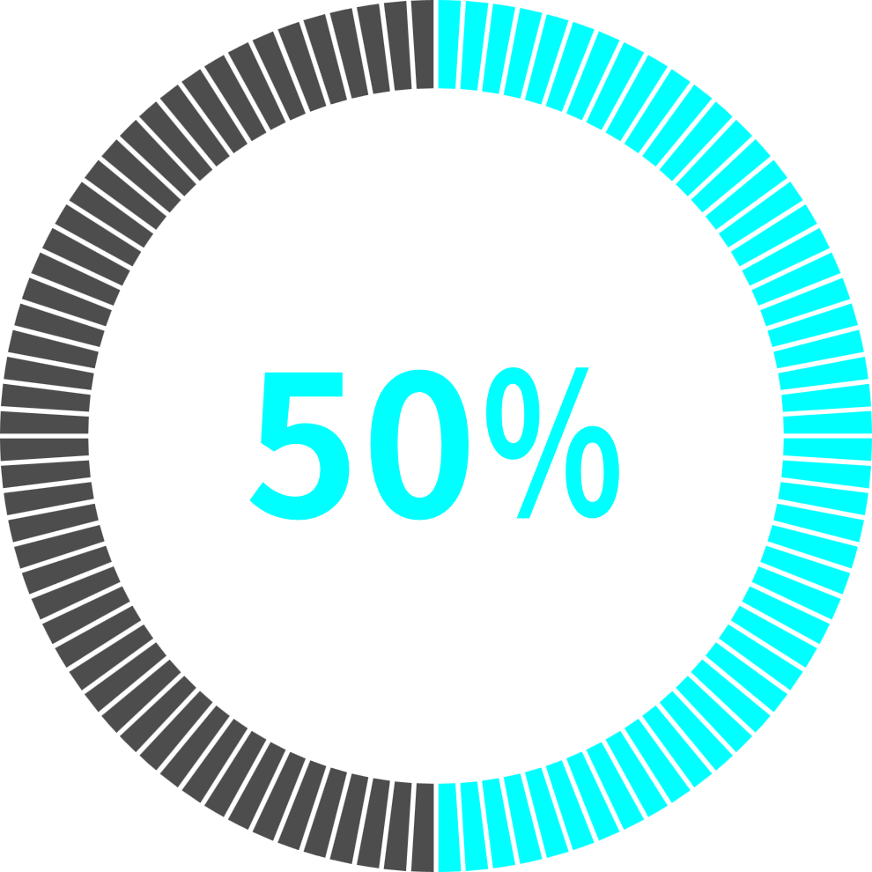
GOAL 2: INCREASE COURSE RETENTION
= Metric has been met
Tactics
Retention Alerts
Affordable and Accessible Course Materials
In summer and fall 2025 the college reorganized retention efforts from an early alert system to a retention alert system and faculty and staff were trained on new processes. In spring 2025 638 alerts were submitted but from fall to fall comparison there was a 149.4% increase in retention alerts. From 328 to 818 fall to fall.
OER open access resources with faculty instead of books. faculty and staff will continue to work toward offering more OERs for in person and software-based classes. Faculty and staff have continued to expand OER offerings.
Timely and Targeted Communication: J1 Communication
J1 Communication was fully implemented. Academic advisors and others are now using it to send timely emails and text messages to students reminding them of important deadlines, events, and to stay connected for resources. A yearly calendar of outreach has been created to help with timeliness of outreach.
Weekly Attendance Tracking and Midterm Grades
Admissions and records has begun using letter grades for midterm instead of pass or failing at midterm. Qwickly attendance in D2L was purchased to help run future weekly attendance reports.
Withdrawal Reasons
Admissions implemented a new drop workflow that included advisor intervention. While the process has improved, some issues remain—particularly with accessing the form. FL 24 70% of withdrawals were admin withdraws. SP 24 new process 140 students requested drops and 77 of those requested to meet with their advisor. 71% of withdrawals were admin withdrawals with no reason.

Slide 9
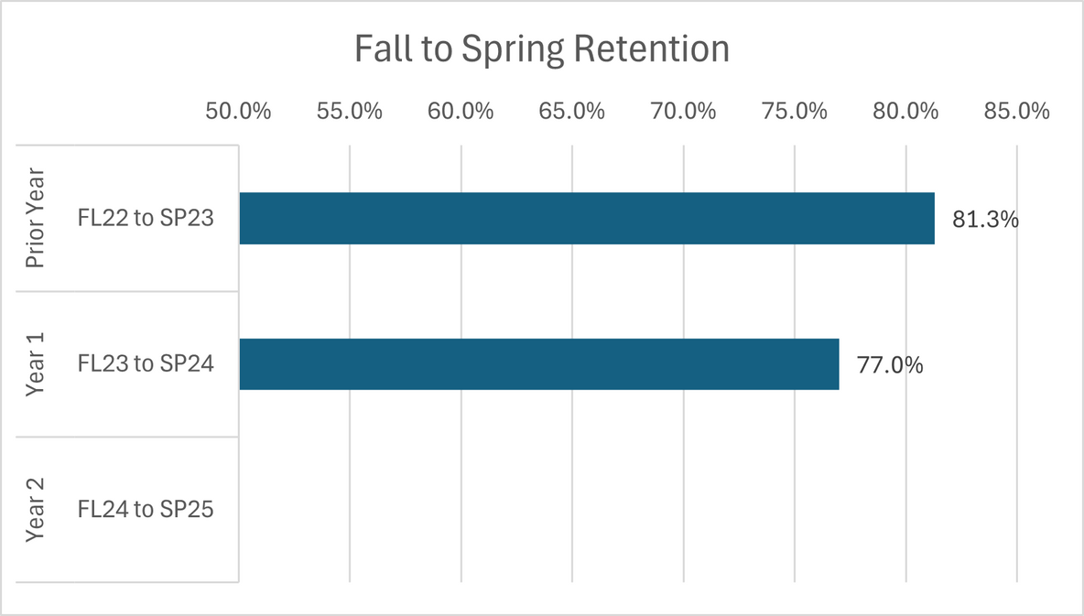
GOAL 2: INCREASE COURSE RETENTION
RESULTS

Slide 10
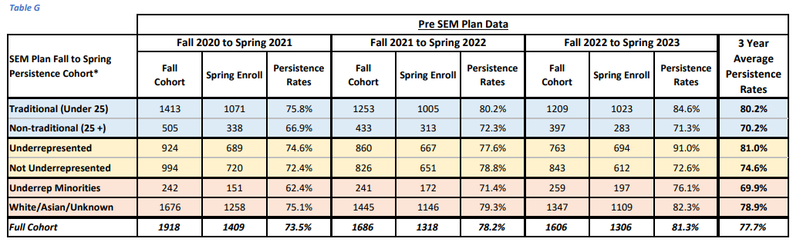
SEM Plan Fall to Spring Persistence: PRE SEM Plan Data
*Retention Cohorts consist of students enrolled in 6 or more credit hours. Excluding Dual Credit, Workforce, and ABE.
Underrepresented-Includes students from the initial cohort that are of any race/ethnicity other than white, Asian, or Unknown OR are Pell recipients OR listed as having a disability. Students who received a degree were also removed.

Slide 11
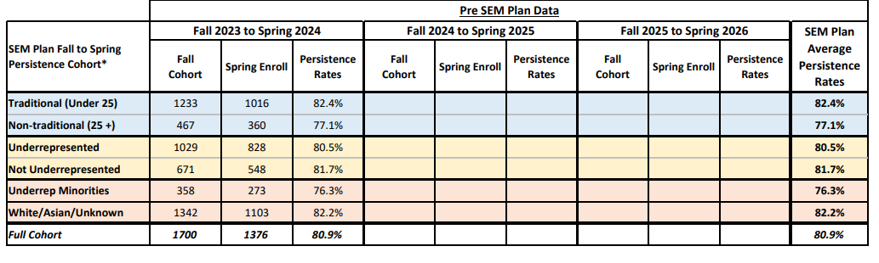
SEM Plan Fall to Spring Persistence: Post Plan Cohort Data
*Retention Cohorts consist of students enrolled in 6 or more credit hours. Excluding Dual Credit, Workforce, and ABE.
Underrepresented-Includes students from the initial cohort that are of any race/ethnicity other than white, Asian, or Unknown OR are Pell recipients OR listed as having a disability. Students who received a degree were also removed.

Slide 12
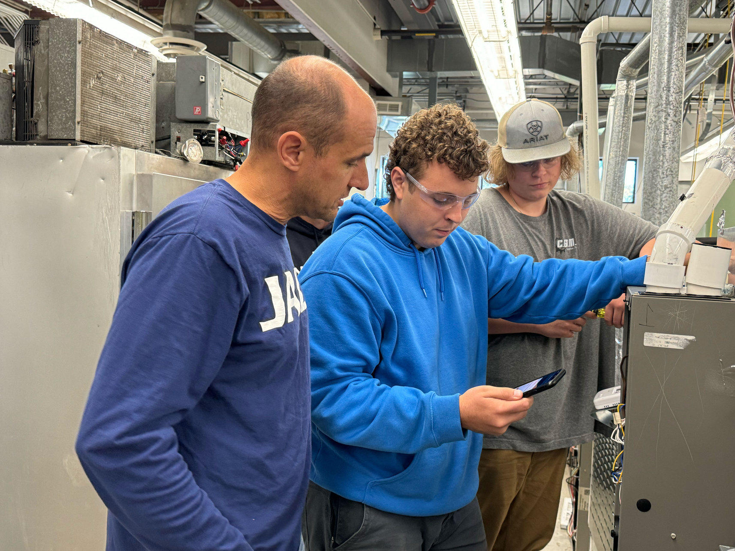
GOAL 3: INCREASE STUDENT PERSISTENCE AND FALL TO FALL RETENTION
= Metric has been met
Tactics
Outreach to Current Students Not Enrolled for Next Semester
Implementation of Student Plans and Pathways
Reports were run between fall to spring to determine how many students had not registered fall to fall and communication via email and phone calls made to students. A summer communication plan occurred to remind students of important dates and deadlines. 884 students who had 30 or more credit hours completed at the college, but no degree awarded received an email about registration and returning. Of the 884 24 of those students registered for Fall 24.
During 2025 the college created career clusters on our website listed 16 new clusters that our programs fall within. This aligned our clusters with the Illinois pathways framework. Phase two of this process will be completed in 2026 with implementing pathways with courses, job outlook, and more.
Access to and Utilization of Tutoring Services
Student Success created a QR code for tutoring services and were placed in high traffic areas. Health Sciences and Nursing hired a full-time tutor. From fall 2022 to fall 2023 total students served for tutoring increased from 89 to 101 and 486 visits to 649 visits.
Meaningful Engagement Opportunities for Students
Several new events were continued in FY24 .Cross campus collaboration with Student Life is the goal was to host at least one event per month. Student Club procedures were updated, and more than five new clubs were created. A new Student Engagement planning calendar was created.
Mental Health Services
The college has continued expanded efforts to offer mental health internal and external resources. The clinical counselor on staff averages 20 scheduled appointments per week plus walk-ins.

Slide 13
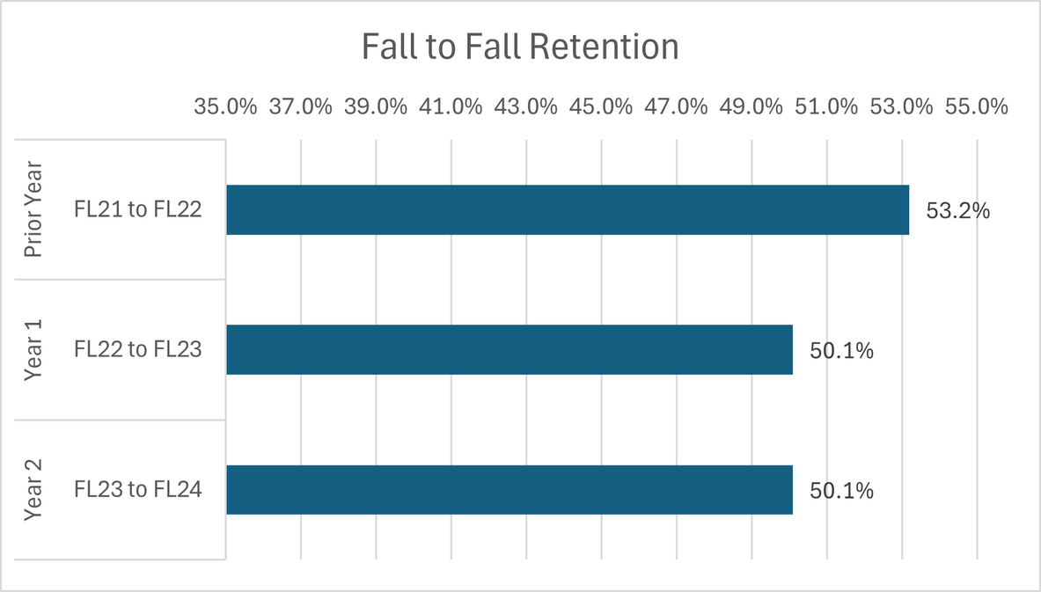
GOAL 3: INCREASE STUDENT PERSISTENCE AND FALL-TO-FALL RETENTION
RESULTS

Slide 14
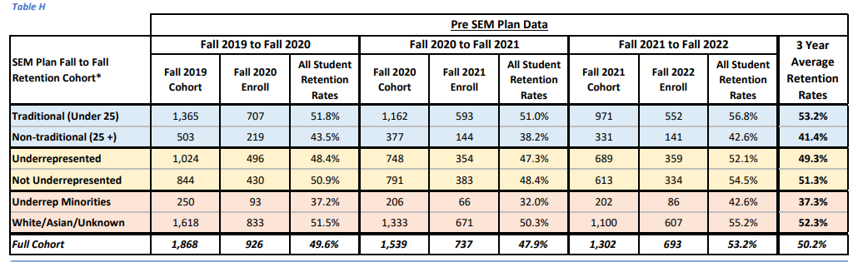
SEM Plan Fall to Fall Retention: Pre SEM Plan Data
*Retention Cohorts consist of students enrolled in 6 or more credit hours. Excluding Dual Credit, Workforce, and ABE.
Underrepresented-Includes students from the initial cohort that are of any race/ethnicity other than white, Asian, or Unknown OR are Pell recipients OR listed as having a disability. Students who received a degree were also removed.

Slide 15
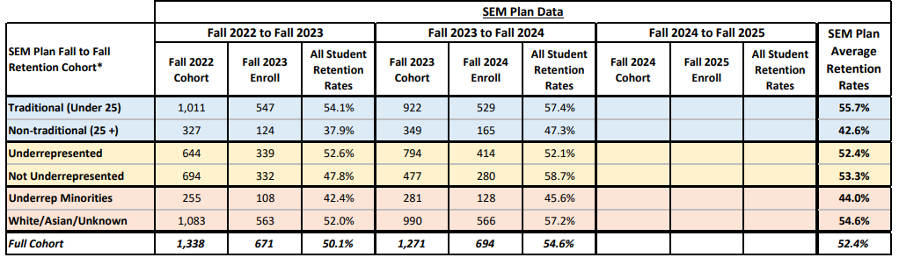
SEM Plan Fall to Fall Persistence: Post Plan Cohort Data
*Retention Cohorts consist of students enrolled in 6 or more credit hours. Excluding Dual Credit, Workforce, and ABE.
Underrepresented-Includes students from the initial cohort that are of any race/ethnicity other than white, Asian, or Unknown OR are Pell recipients OR listed as having a disability. Students who received a degree were also removed.

Slide 16
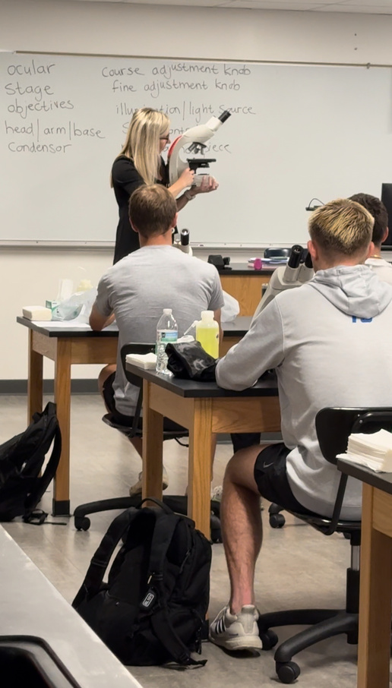
GOAL 4: INCREASE PROGRAM COMPLETIONS AND GRADUATION RATES
= Metric has been met
Tactics
Improve Post Graduation Tracking
Admissions will email fall graduates the supplemental survey and check in with IER regarding the results in February/March.
Implementation of New Graduation Survey
A new graduation survey was successfully updated and added to the website and Admissions, Enrollment Management and IER will access data in FY25.
Removal of Financial Barriers to Graduation
Admissions eliminated the graduation application fee and decreased the price of regalia from $40 to $17. The college had 239 students attend graduation in 2024 which was an increase from 207 students in 2023.
Promotion of the Graduation Ceremony
Admissions has made greater efforts in communications to students utilizing J1 Communication and hosting graduation drive events to get students to apply for graduation. The decrease in price of regalia and the removal of the application fee helped to promote graduation in 2024.
Student Application for All Eligible Credentials
Admissions tested a new set-up for awarding GECC and made a few changes, but it threw off financial aid. We are corresponding with our IT department.

Slide 17
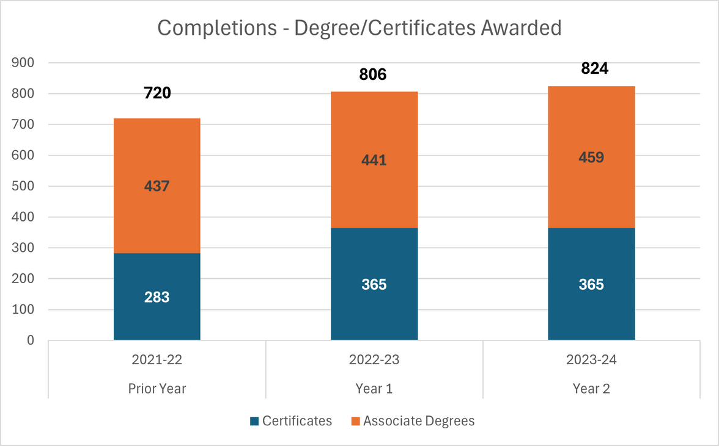
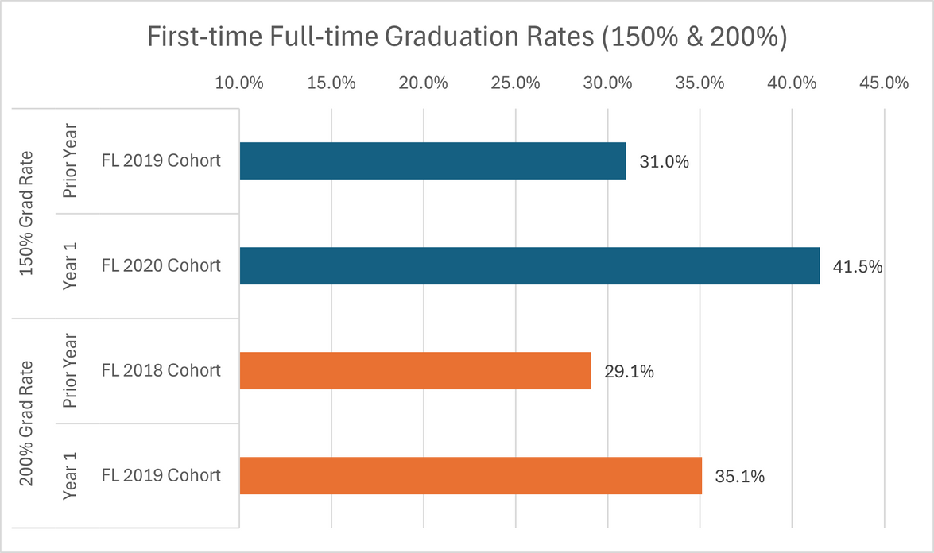
GOAL 4: INCREASE PROGRAM COMPLETIONS AND GRADUATION RATES
RESULTS

Slide 18
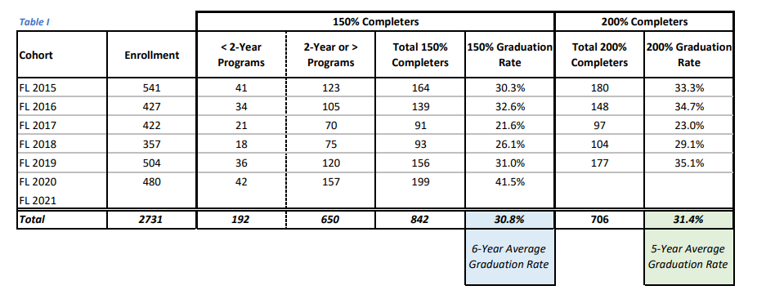
FTFT Graduation Rate
- Prior to the 2019-20 academic year, all completions of certificates under 1 year were reported together. Starting in the 2019-20 academic year these completions were reported separately for certificates under 300 clock hours and certificates between 300 and 899 clock hours.

Slide 19
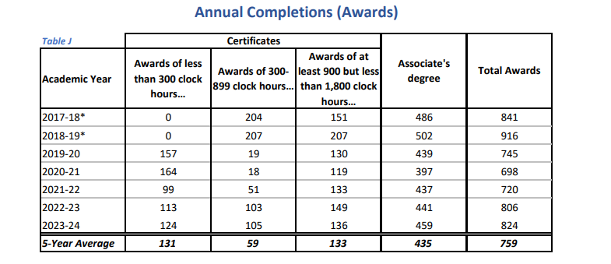
Annual Completion (Awards)
- Prior to the 2019-20 academic year, all completions of certificates under 1 year were reported together. Starting in the 2019-20 academic year these completions were reported separately for certificates under 300 clock hours and certificates between 300 and 899 clock hours.

Slide 20
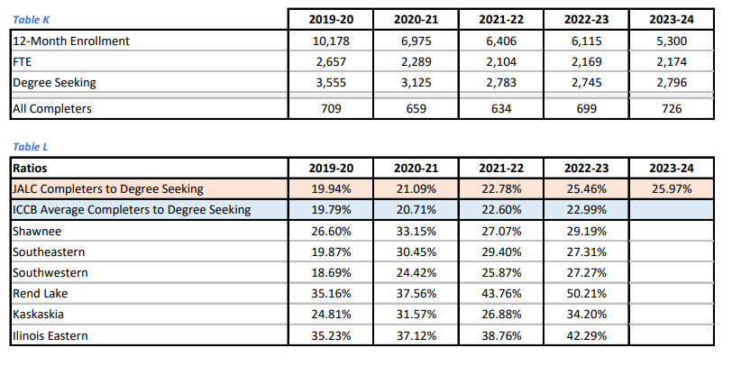
Annual Completers to 12-Month Enrollment Ratio
-The ratios are created based on the number of unduplicated completers divided by the number of degree seeking unduplicated 12-month enrollment

