Slide 1
Women’s History Month
Celebration
A Panel Discussion
PRESENTED BY JOHN A. LOGAN COLLEGE
DIVERSITY & INCLUSION OFFICE
Wednesday, March 24th, 2021 via Zoom

Slide 2
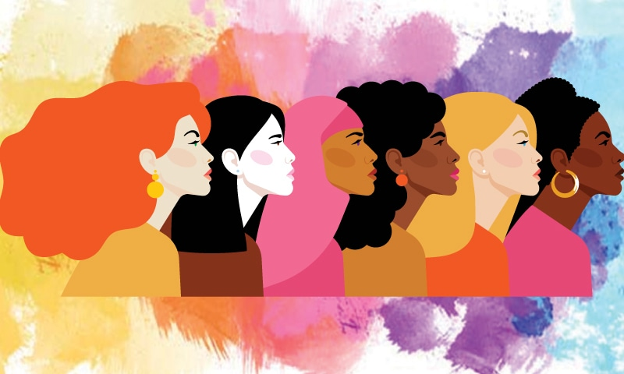
Countries Currently Led by Women
Source https://247wallst.com/special-report/2020/03/04/countries-currently-led-by-a-woman/2/

Slide 3
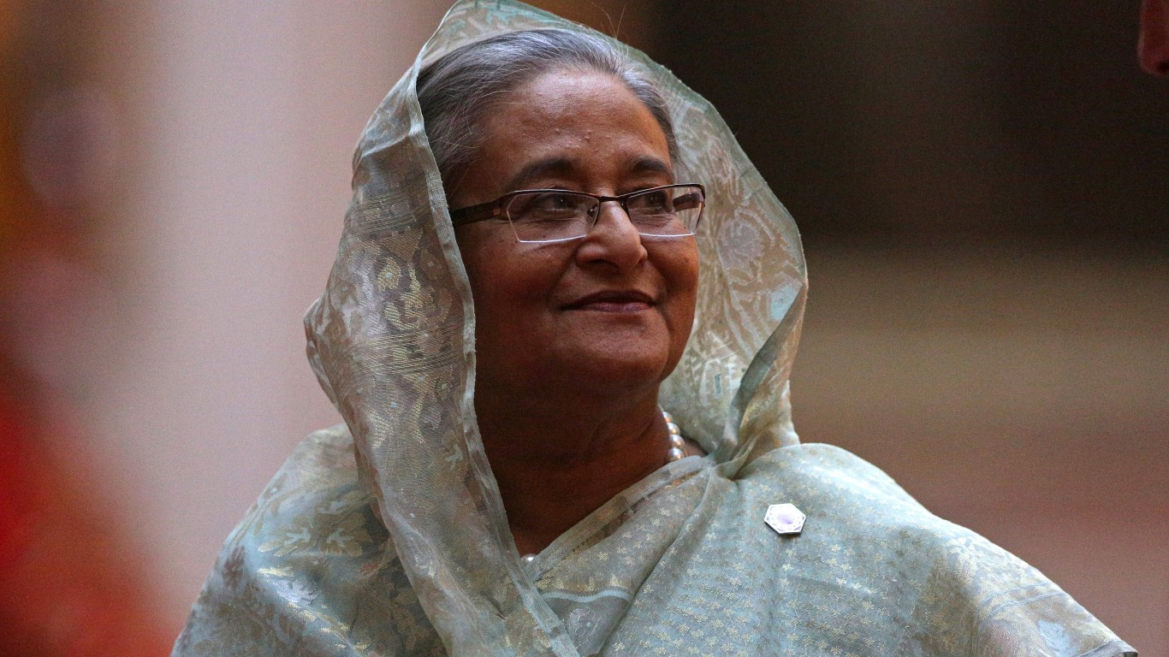
Prime Minister of Bangladesh:
Sheikh Hasina Wajed
First elected back in 1996, she began serving her second tenure in 2009, and is now the long serving Prime Minister of Bangladesh
Hasina is considered one of the most powerful women in the world, according to Forbes Magazine.

Slide 4
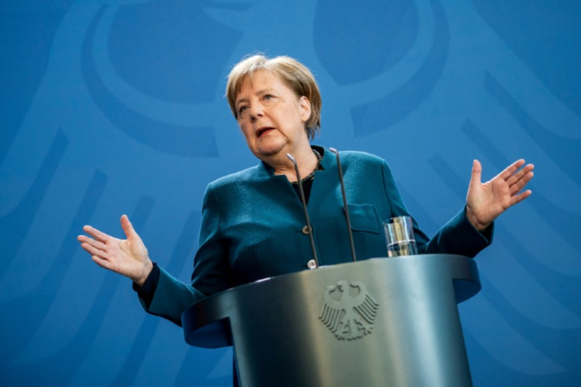
Chancellor of Germany:
Angela Merkel
Elected to office in 2005
Cited as “the de facto leader of the European Union”
As first woman chancellor of Germany, she focused on strengthening the European financial crisis

Slide 5
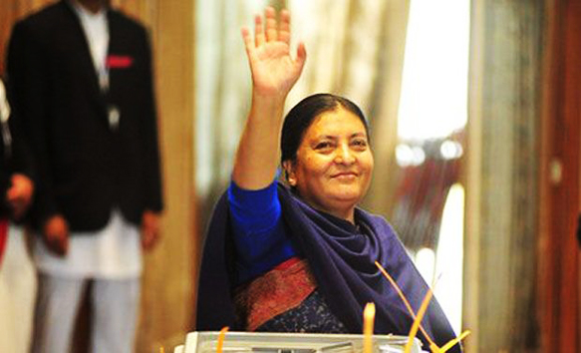
President of Nepal:
Bidhya Devi Bhandari
Nepal’s first woman president, elected back in 2015
A strong women’s rights advocate focused on equality of women’s roles in parliament.

Slide 6
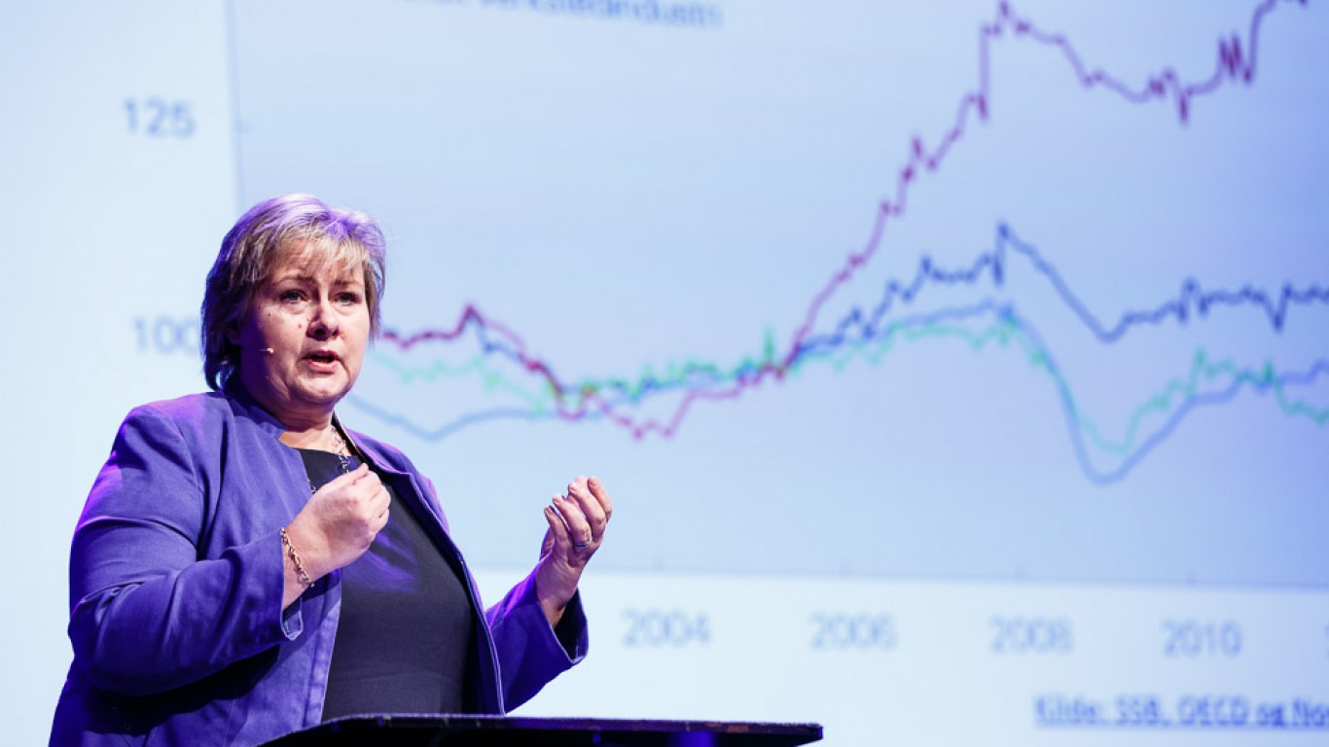
Prime Minister of Norway:
Erna Solberg
Solberg is the second woman to be elected Norway’s prime minister.
Avoided a recession by her handling of the oil crisis during the mid-2010s.

Slide 7
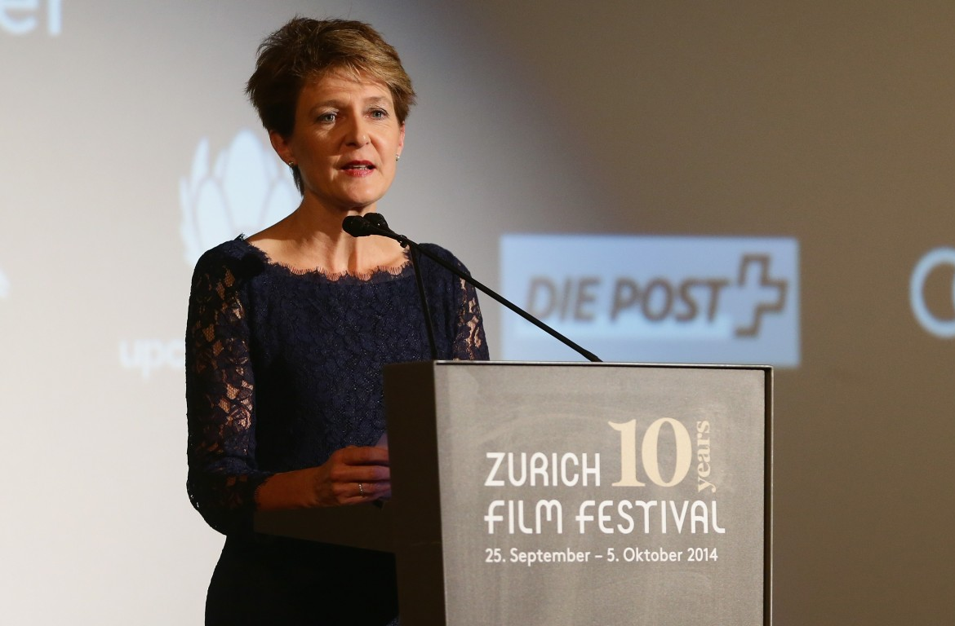
President of Switzerland: Simonetta Sommaruga
Served as Vice President in 2014 and 2019 before becoming President first in 2015.
A member of the Social Democratic Party (SP/PS), she has been a Member of the Swiss Federal Council since 2010

Slide 8
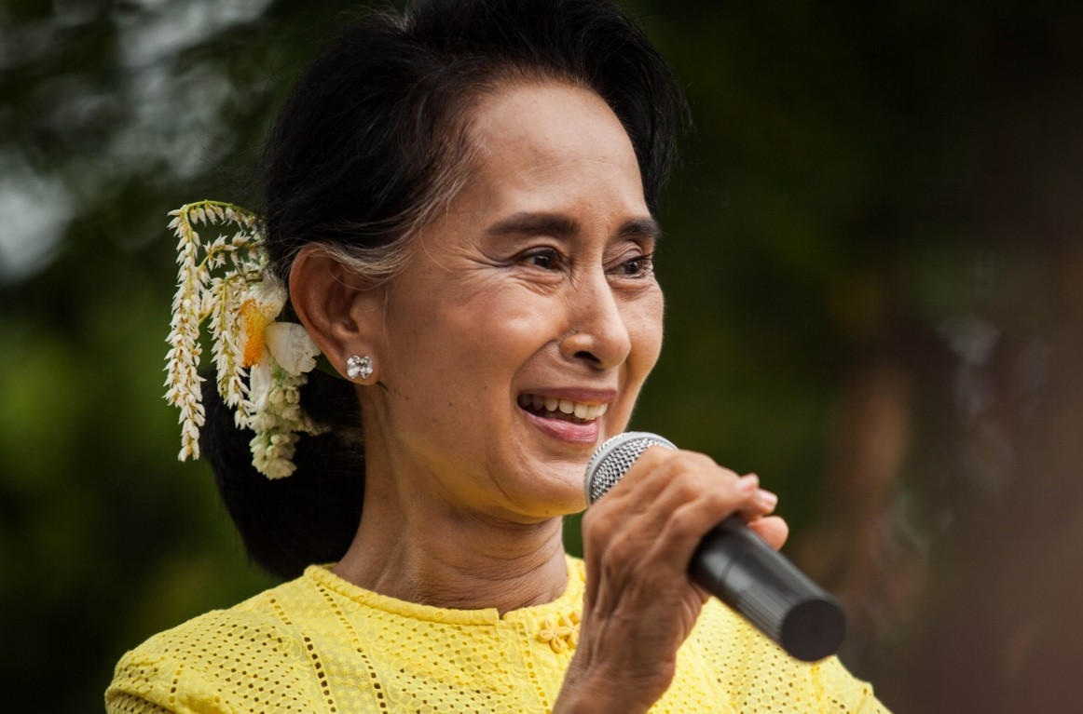
De facto leader of Myanmar: Aung San Suu Kyi
Officially a state counsellor, she was disqualified from running for president
A 1991 Nobel Peace Prize winner
Daughter of Aung San, a national hero of independent Burma

Slide 9
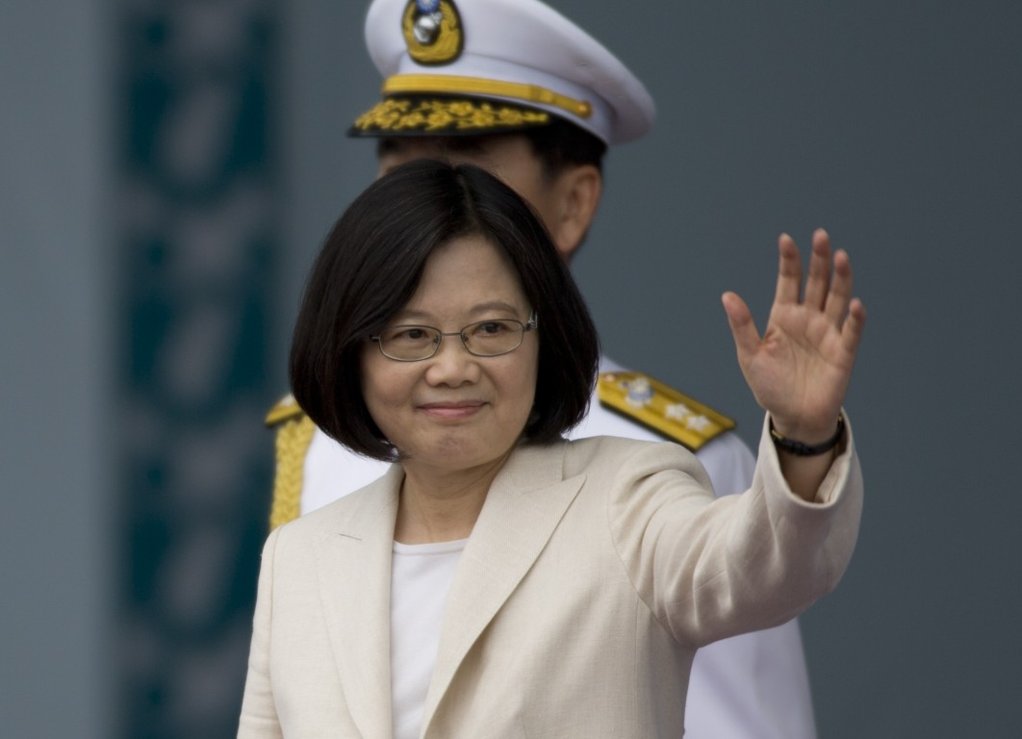
President of Taiwan:
Tsai Ing-wen
First woman elected to the post of head of state in Taiwan’s history
She has been in office since 2016.
Supports a sovereign Taiwan

Slide 10
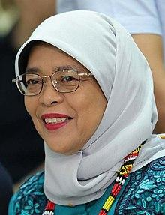
President of Singapore: Halimah Yacob
First woman president of Singapore
Entered office in 2017 after an uncontested election, becoming the first Muslim to be in office since 1965

Slide 11
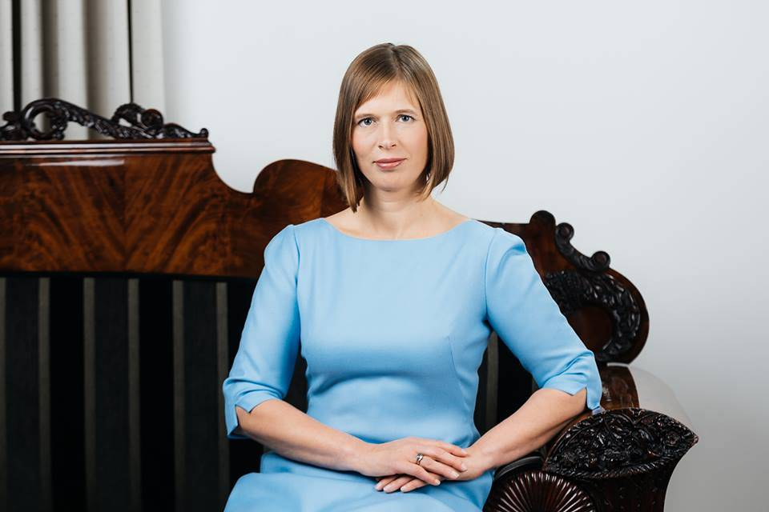
President of Estonia:
Kersti Kaljulaid
President of the Baltic nation since 2016 as the first woman president of Estonia.
Previously, Kaljulaid was an economic adviser involved in pension reform

Slide 12
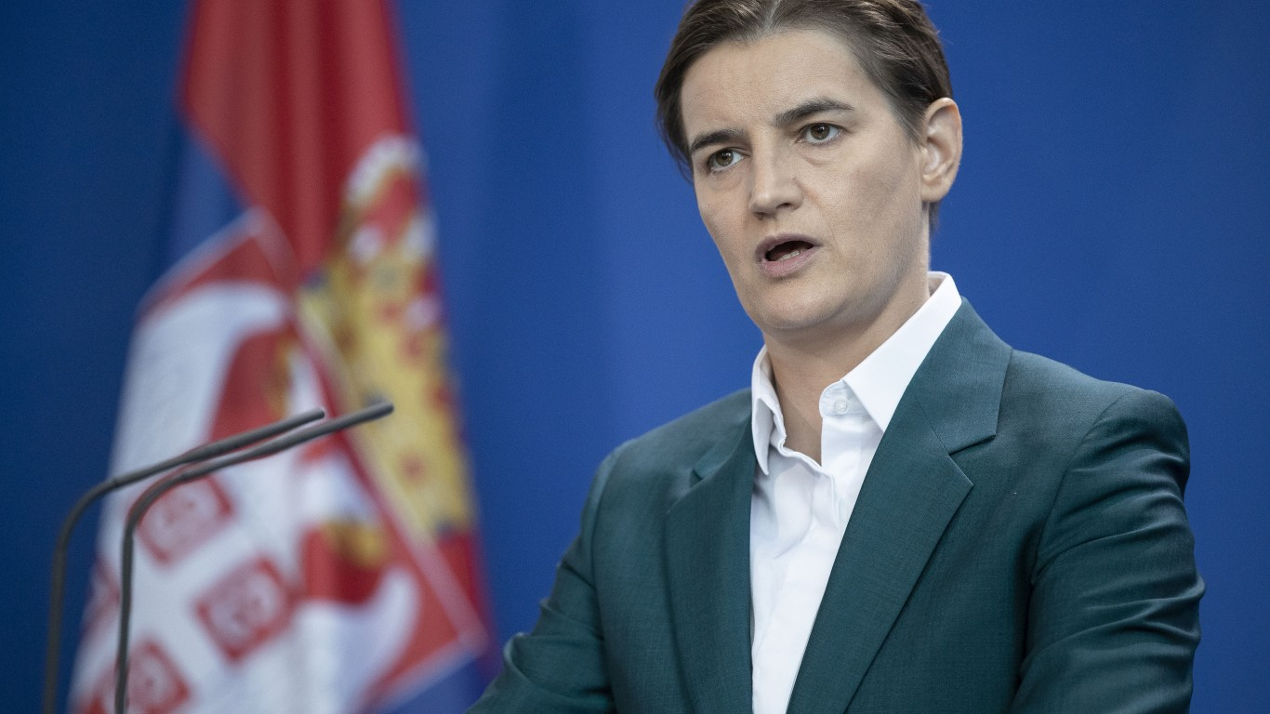
Prime Minister of Serbia:
Ana Brnabić
Serbia’s first prime minister and the Balkan nation’s first openly gay leader.
Supports entrepreneurship and is an advocate for sustainable energy/power.

Slide 13
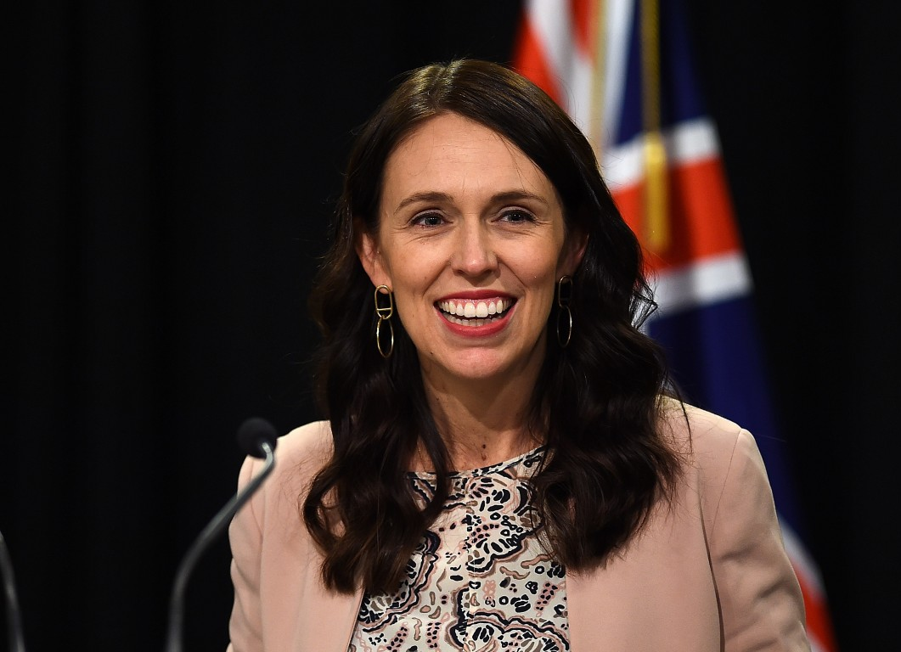
Prime Minister of New Zealand:
Jacinda Ardern
At the age of 37, Ardern is the youngest prime minister of New Zealand in more than 150 years
Elected in 2017, her accomplishments include creating almost 100,000 jobs, building state houses, planting millions of trees, and improving cancer care and treatment.

Slide 14
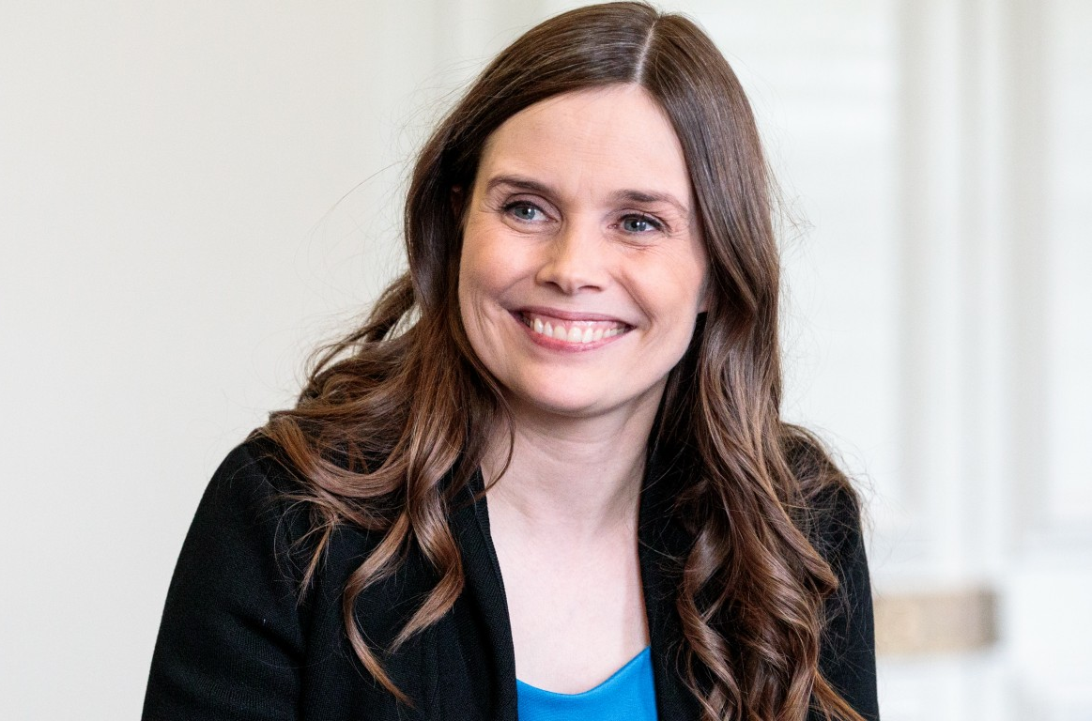
Prime Minister of Iceland:
Katrín Jakobsdóttir
The second woman Prime Minister of Iceland.
Concerned about global climate change with a goal to make Iceland carbon-neutral by 2040

Slide 15
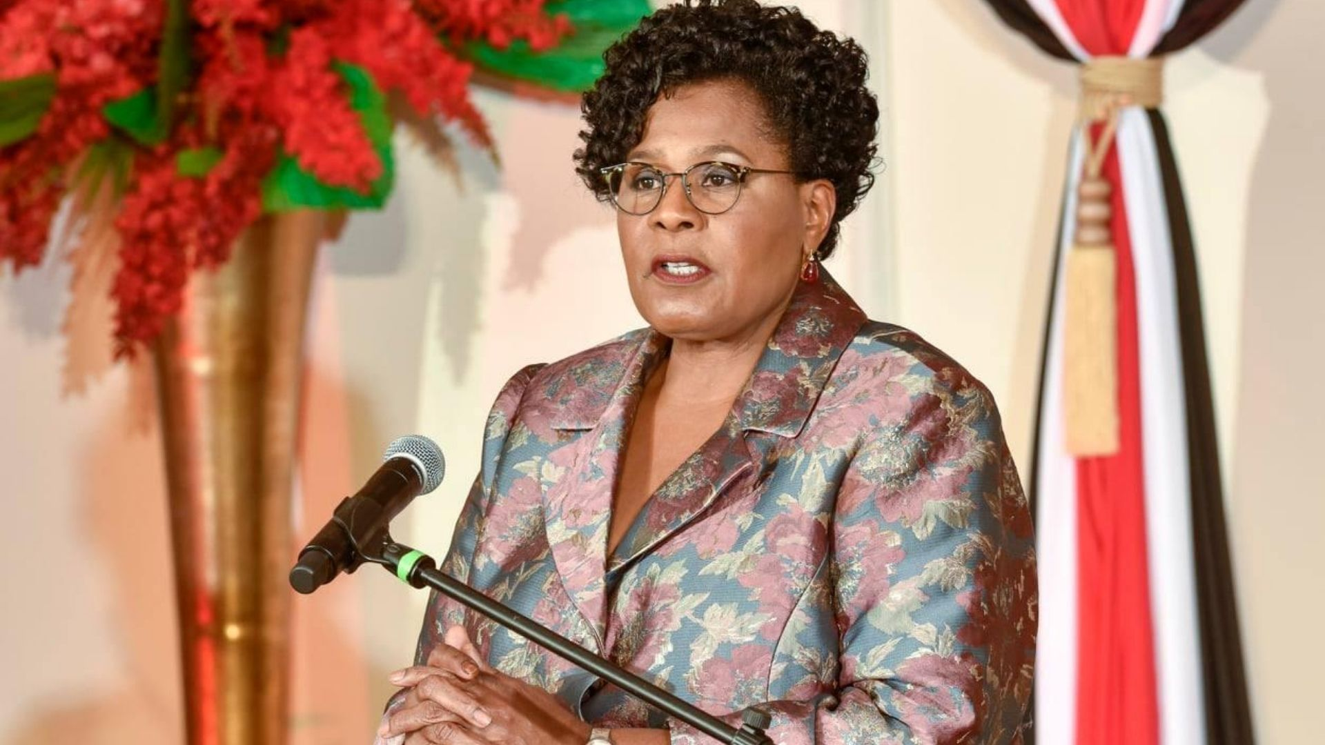
President of Trinidad and Tobago:
Paula-Mae Weekes
First woman president of the Caribbean nation, elected in 2018
Comes from an extensive legal background and served as chancellor of the Anglican Church for 20 years

Slide 16
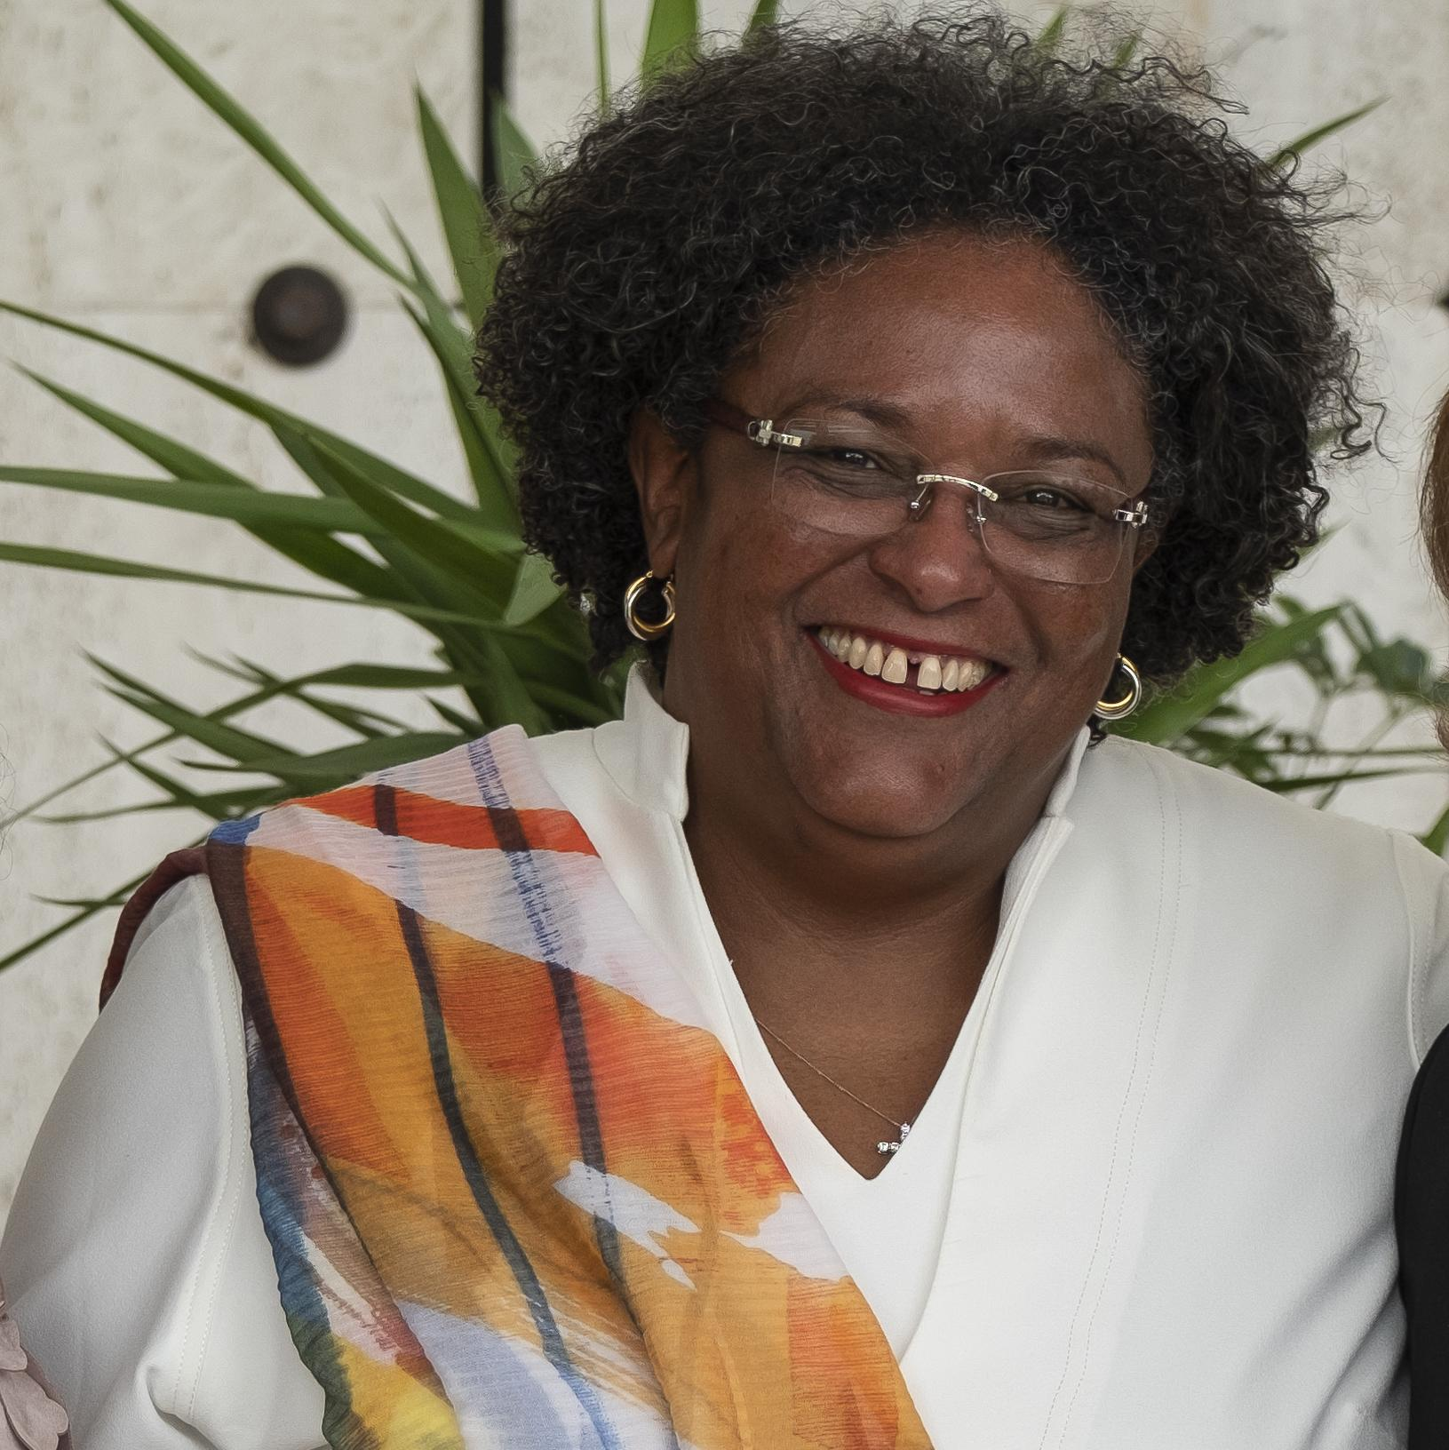
Prime Minister of Barbados:
Mia Mottley
Elected in 2018 to become the first woman prime minister of Barbados
Appointed Attorney-General in 2001 as the first female to hold this position.
The youngest ever Queen's Counsel in Barbados

Slide 17
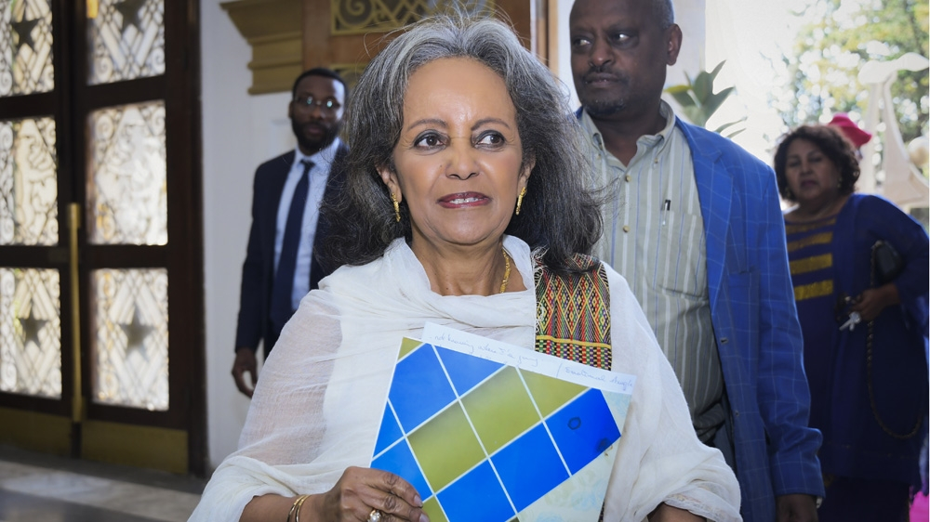
President of Ethiopia:
Sahle-Work Zewde
Sahle-Work Zewde has made gender equality the mission of her tenure.
Assumed office in 2018 as Ethiopia’s first woman president

Slide 18
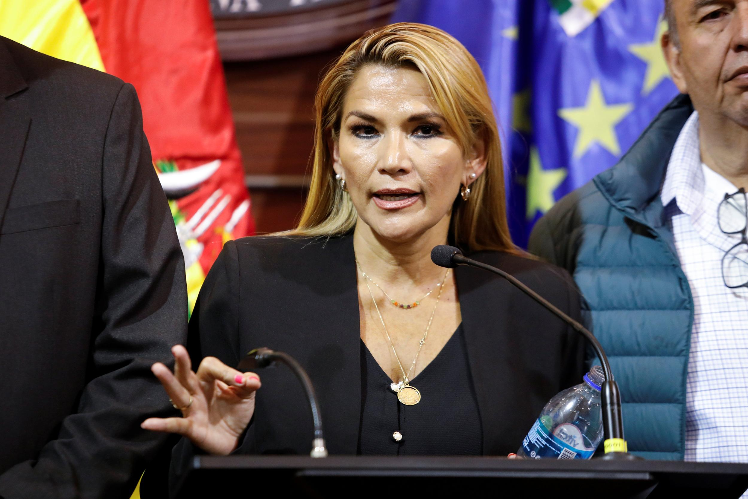
interim President of Bolivia:
Jeanine Áñez
Took over when the former president fled the country after an election scandal
Formerly a senator, she announced that she will officially run for president

Slide 19
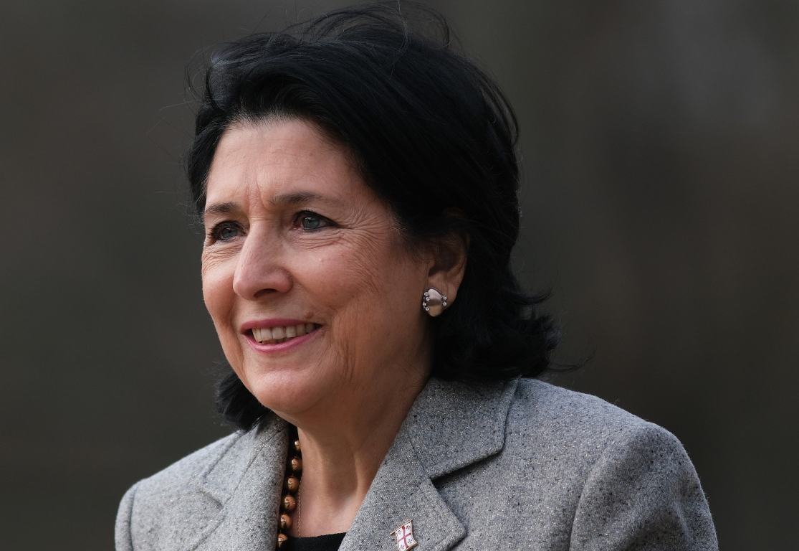
President of Georgia:
Salome Zurabishvili
The first woman elected president of Georgia
Previously served as the Ambassador of France to Georgia

Slide 20
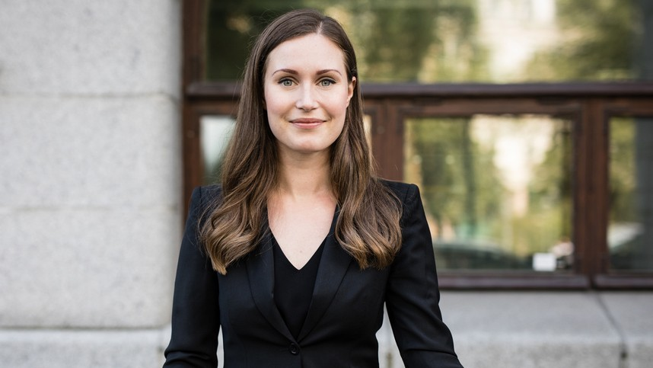
Prime Minister of Finland:
Sanna Marin
All of Finland’s major political parties are headed by women, and three of the leaders are under 35 years old.
Marin is the youngest leader of a nation in the world at 34.

Slide 21
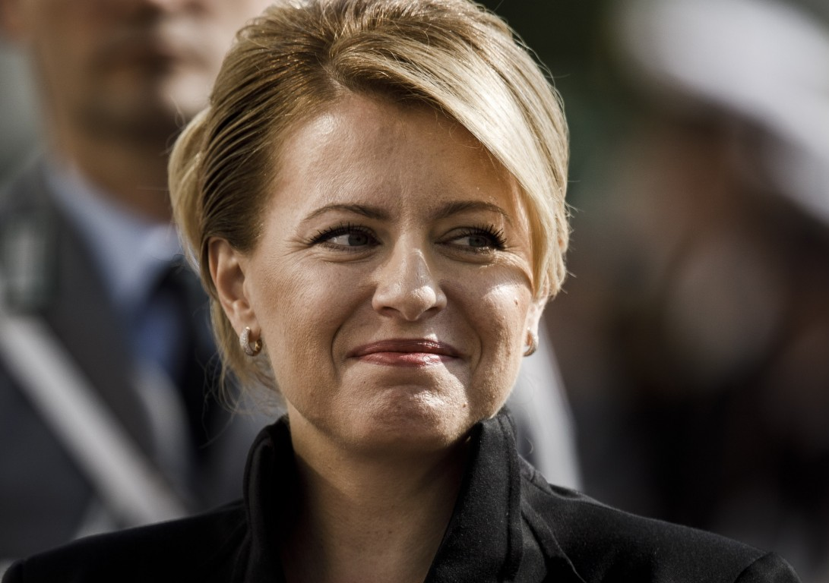
President of Slovakia:
Zuzana Čaputová
Previously an environmental lawyer, she was elected first woman president of Slovakia in 2019
An advocate for LGBT rights and more left-leaning politics

Slide 22
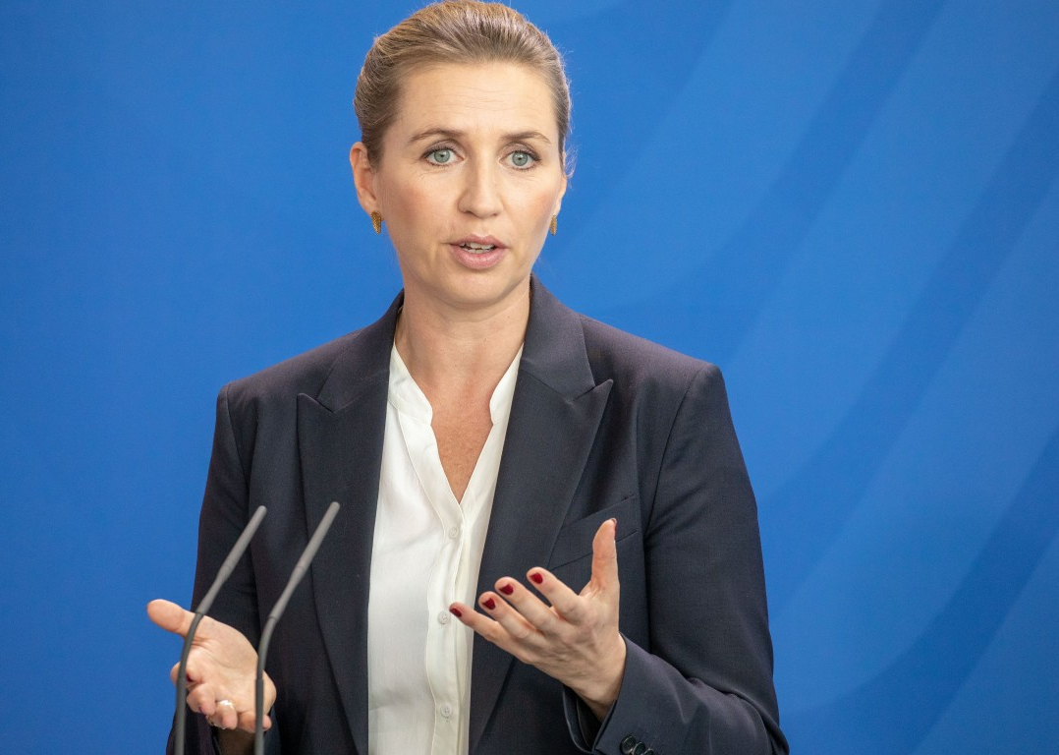
Prime Minister of Denmark:
Mette Frederiksen
Elected in 2019, Frederiksen, at 41, is Denmark’s youngest prime minister ever.
She is the leader of the center-left Socialist Democratic party

Slide 23
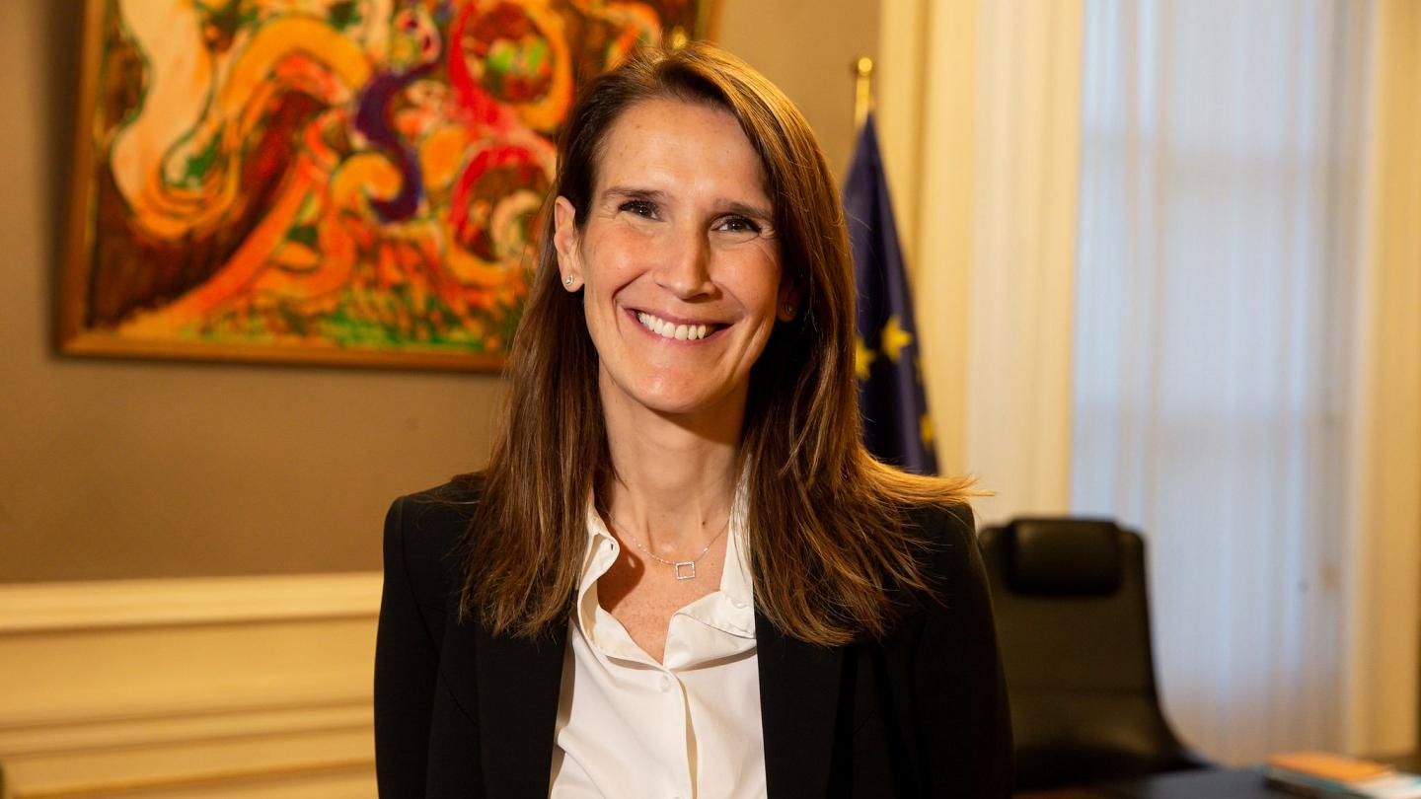
Prime Minister of Belgium:
Sophie Wilmès
Became the first woman prime minister of Belgium in 189 years
Comes from a political family, as a member of the nation’s francophone liberal party

Slide 24
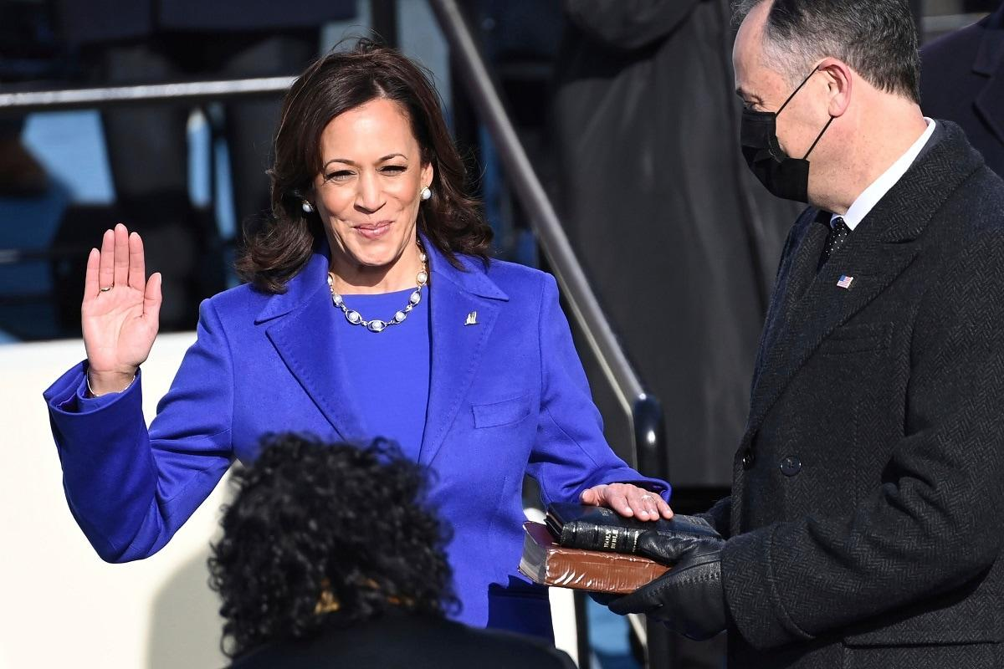
Vice President of the United States:
Kamala Harris
First Black and South Asian woman Vice President elected in 2020.
Former senator and Attorney-General of California

Slide 25
References
https://247wallst.com/special-report/2020/03/04/countries-currently-led-by-a-woman/2/
Wikipedia
PBS.org
https://www.statista.com/statistics/1058345/countries-with-women-highest-position-executive-power-since-1960/

