Slide 1


Valiant Women of the Vote
2020

Slide 2
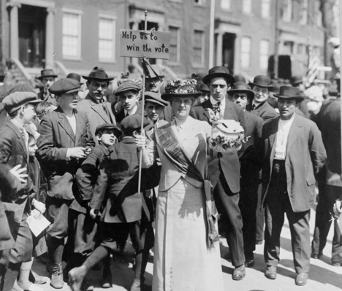
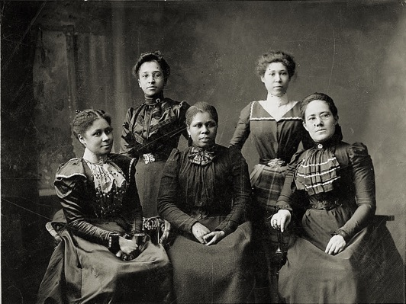
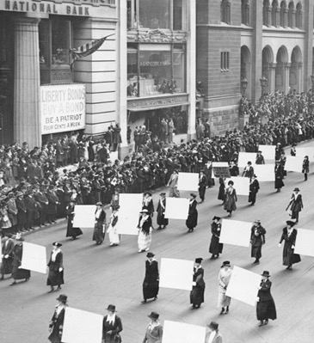
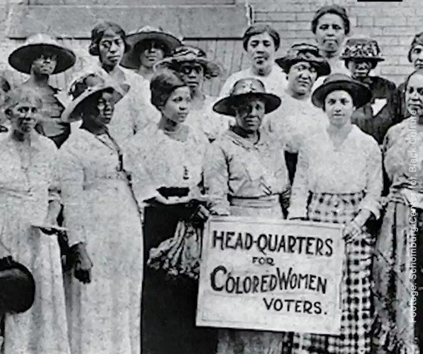
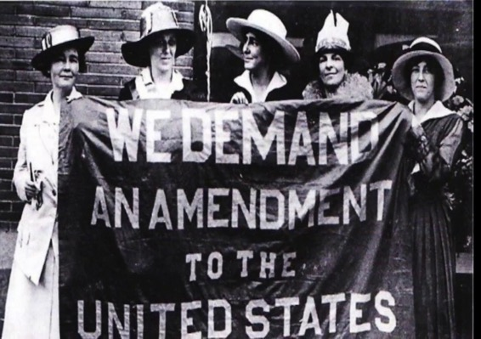


Slide 3
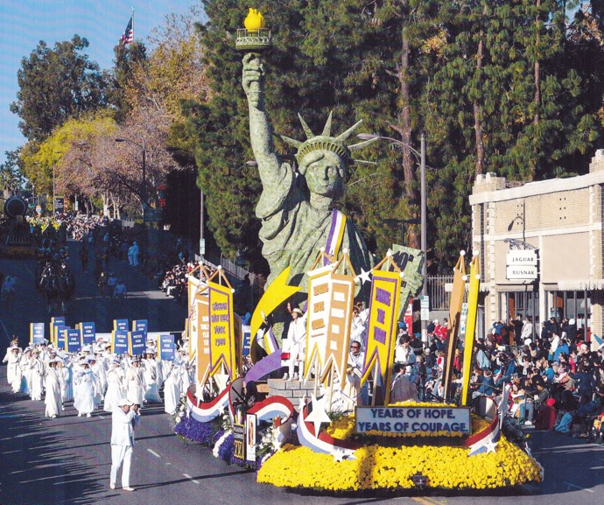
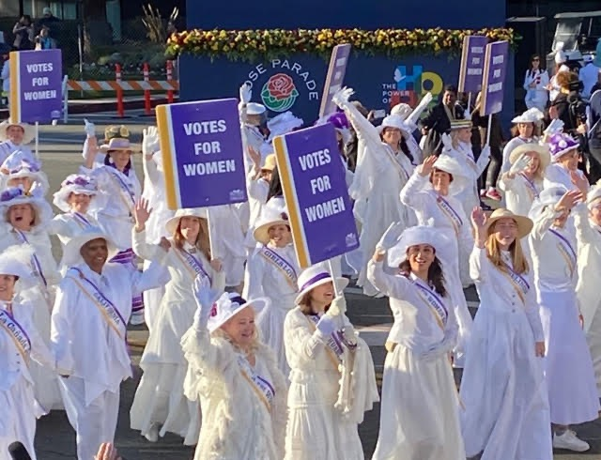


Slide 4
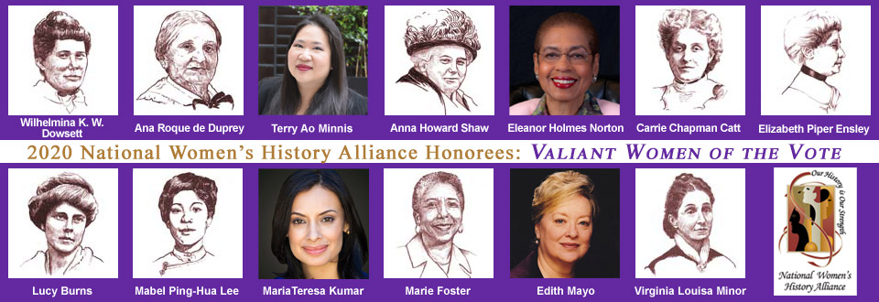
Valiant Women of the Vote
2020

Slide 5

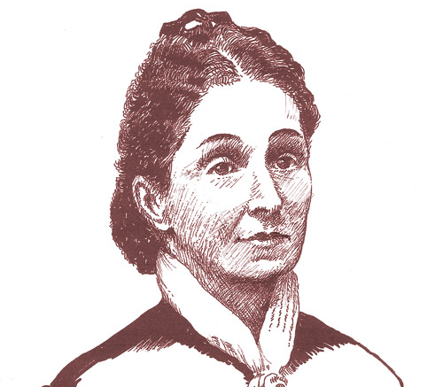
Virginia
Louisa Minor
Founded Woman Suffrage Association of Missouri
Believed 14th amendment was the path to votes for women
Took her case before the Supreme Court Minor v. Happersett

Slide 6
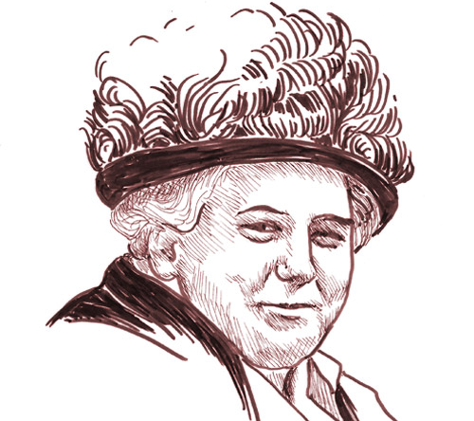
Anna
Howard Shaw
Famous Orator
Close friend of Susan B. Anthony
President of National Woman Suffrage Association
Distinguished Service Medal for WWI

Slide 7
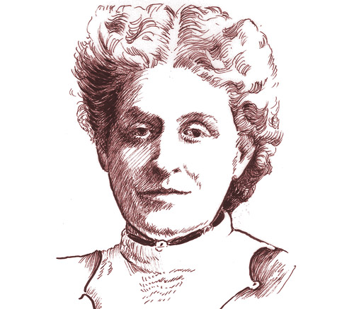
Carrie
Chapman Catt
President of the National Suffrage Association
”Winning Plan” coordinated suffrage campaign
Started League of Women Voters

Slide 8
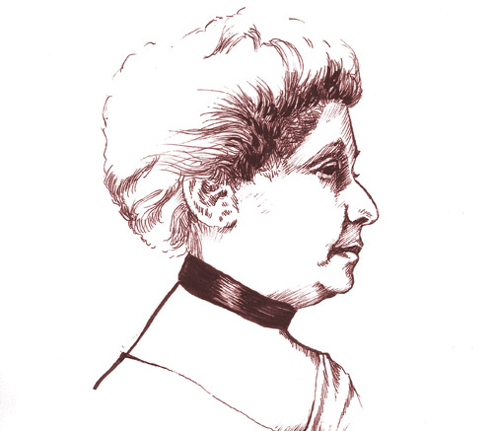
Elizabeth
Piper Ensley
Organized suffragists in Colorado
Correspondent for “Women’s Era”
Founded Federation of Colored Women’s Club

Slide 9
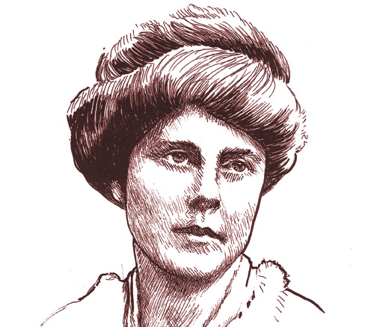
Lucy
Burns
Silent Sentinel arrested for picketing White House
Cherished suffrage leader
Co-founded National Woman’s Party

Slide 10
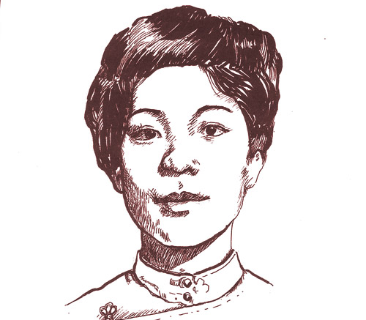
Mabel
Ping-Hua Lee
Marched in 1912 suffrage parade at 16 years old
Advanced degree in Economics
Respected Community Member

Slide 11
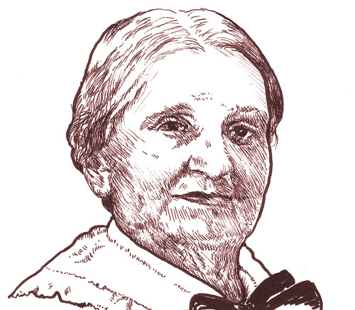
Ana
Roque de Duprey
Puerto Rican suffragist leader
Writer & publisher of magazines & newspapers
Teacher & educator

Slide 12
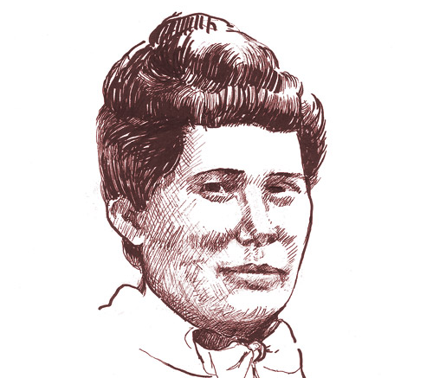
Wilhelmina
Kekelaokalaninui Wideman Dowsett
Hawaiian suffragist leader
Founded National Women’s Equal Suffrage Association of territory of Hawai’i
Lead 500 women to flood the legislature carrying “Votes for Women” banners

Slide 13
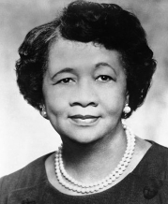
Marie
Foster
Civil Rights Activist
Marched from Selma to Montgomery, 1965
Registered 8 times to vote before she was allowed to access her right
“mother of Voting Rights”

Slide 14
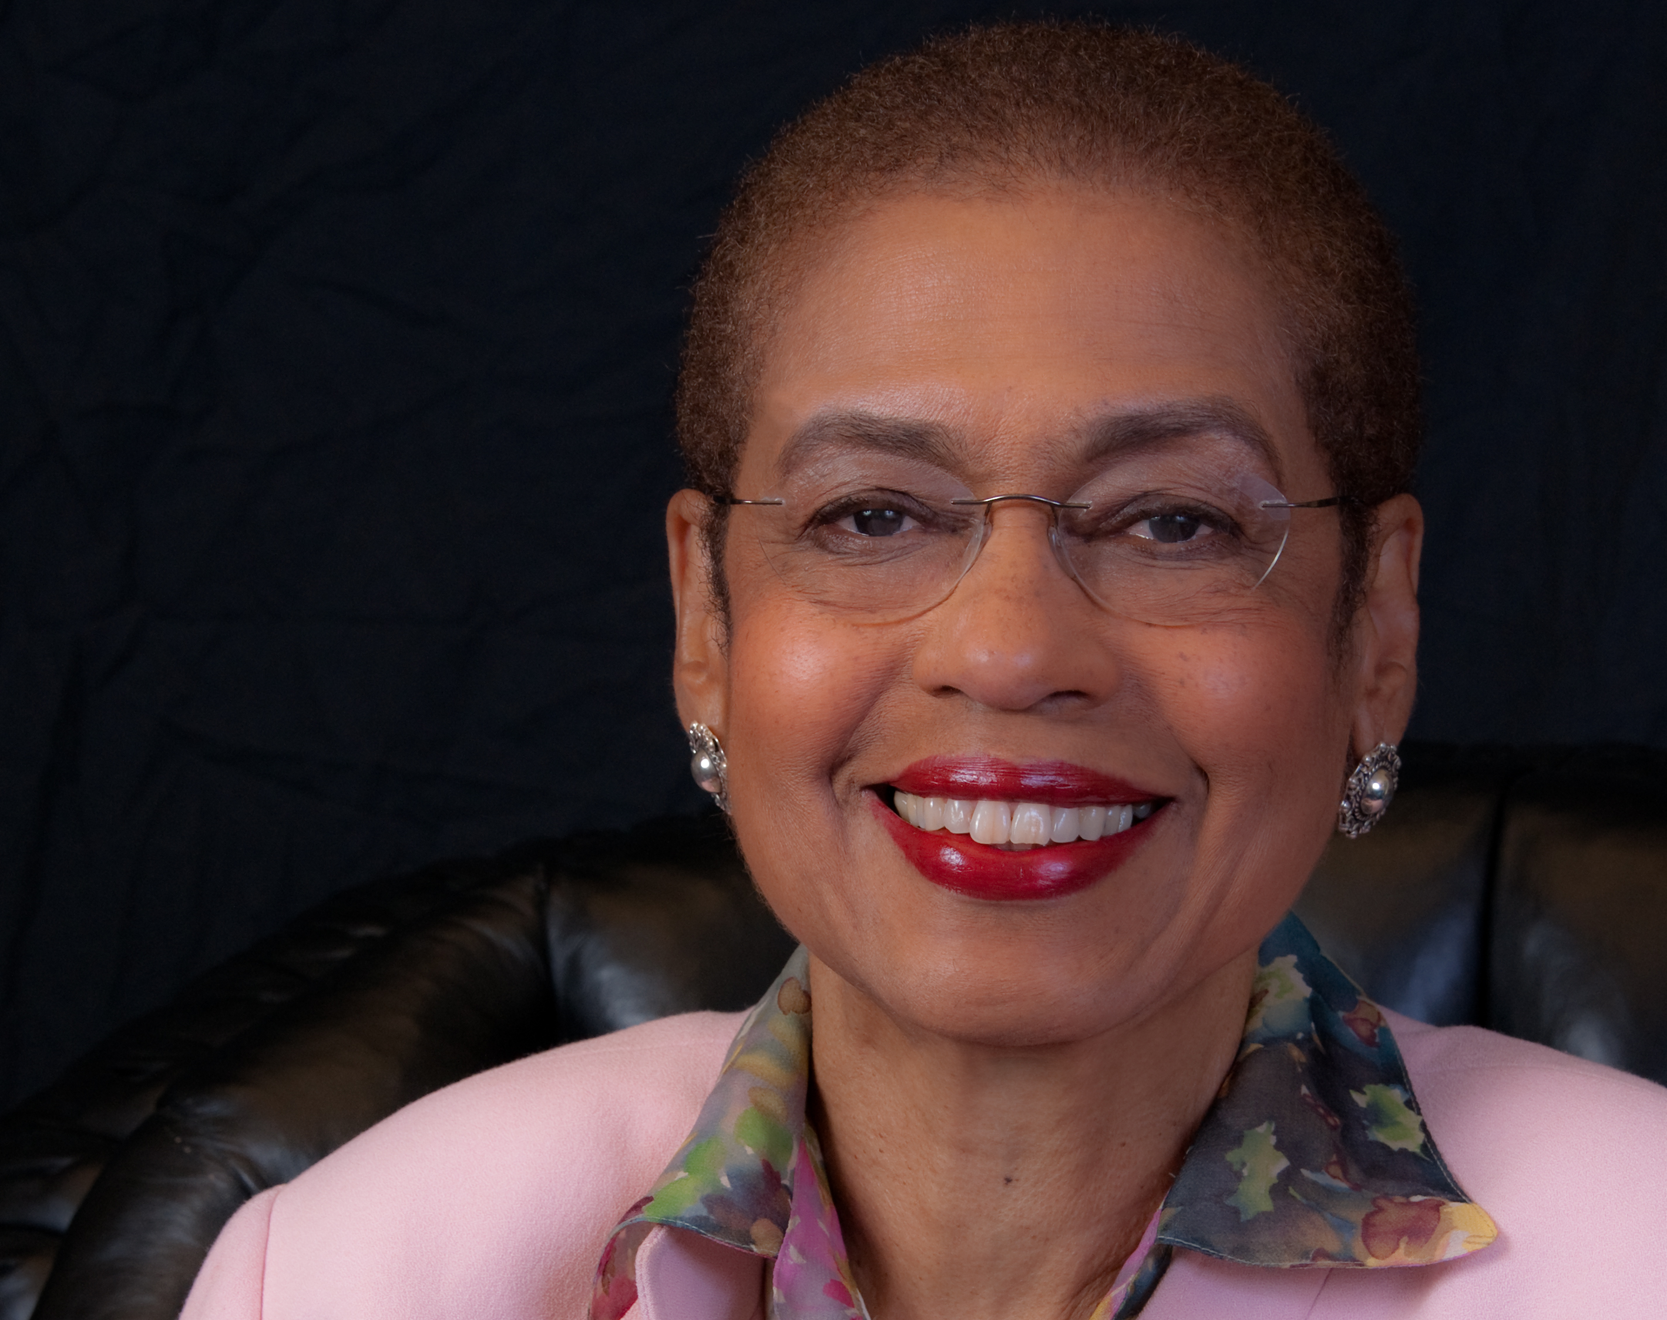
Eleanor
Holmes Norton
Civil Rights Leader
Congressional Representative for District of Columbia
Registered Voters during Mississippi Freedom Summer

Slide 15
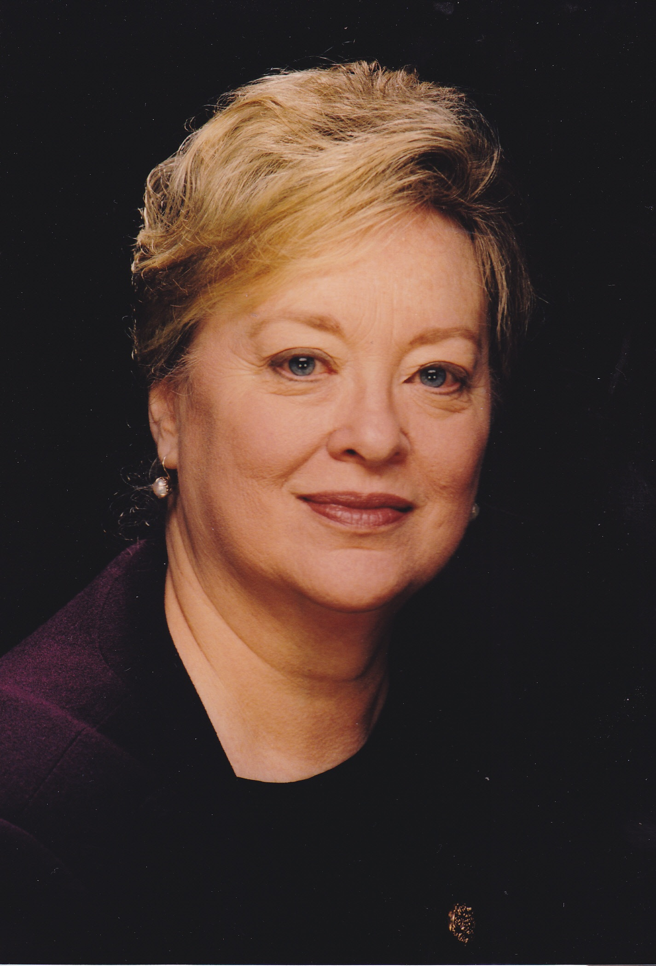
Edith
Mayo
Changed the way museums featured women’s history exhibits
Curator Emerita of Political History at the National Museum of American History
Curated Parlor to Politics: Women and Reform in America, 1890-1925

Slide 16
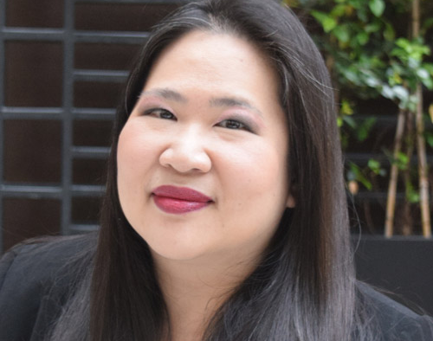
Terry
Ao Minnis
Leading the efforts to protect Asian American Voting Rights
Led campaign to reauthorize Voting Rights Act
Co-chairs Census Task Force that promotes and seeks to protects the rights of all people

Slide 17
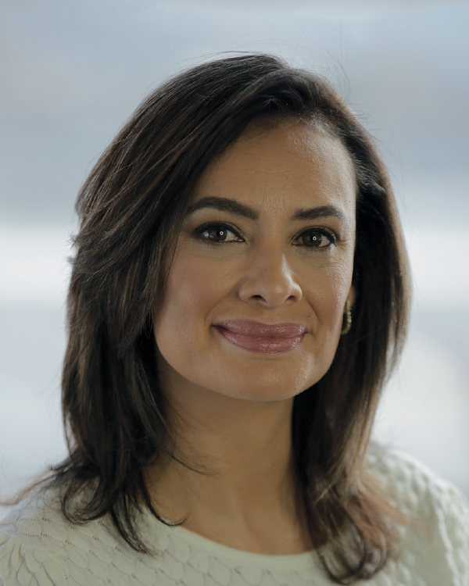
Maria Teresa Kumar
Founding president of Voto Latino
Voting advocate for youth
Helped to registered over a quarter a million voters

Slide 18
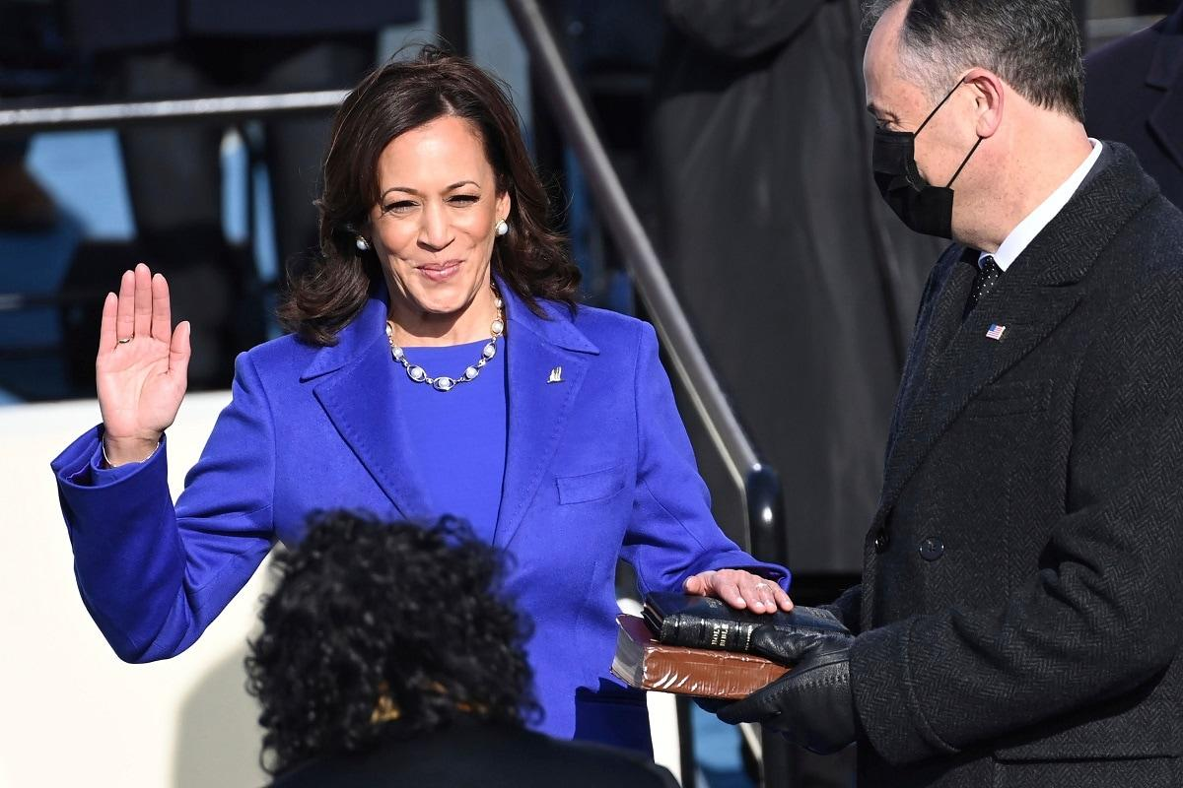
Vice President of the United States:
Kamala Harris
First Black and South Asian woman Vice President elected in 2020.
Former senator and Attorney-General of California

Slide 19
For more information & downloadable resources visit the
National Women’s History Alliance at nwha1980.org

